Slide 1
AIMS Update
Amsterdam NL September 2022

Slide 2
Our Mission
To foster the adoption of one set of common, ubiquitous, standards-based protocols for interoperability over IP in the media and entertainment industry

Slide 3
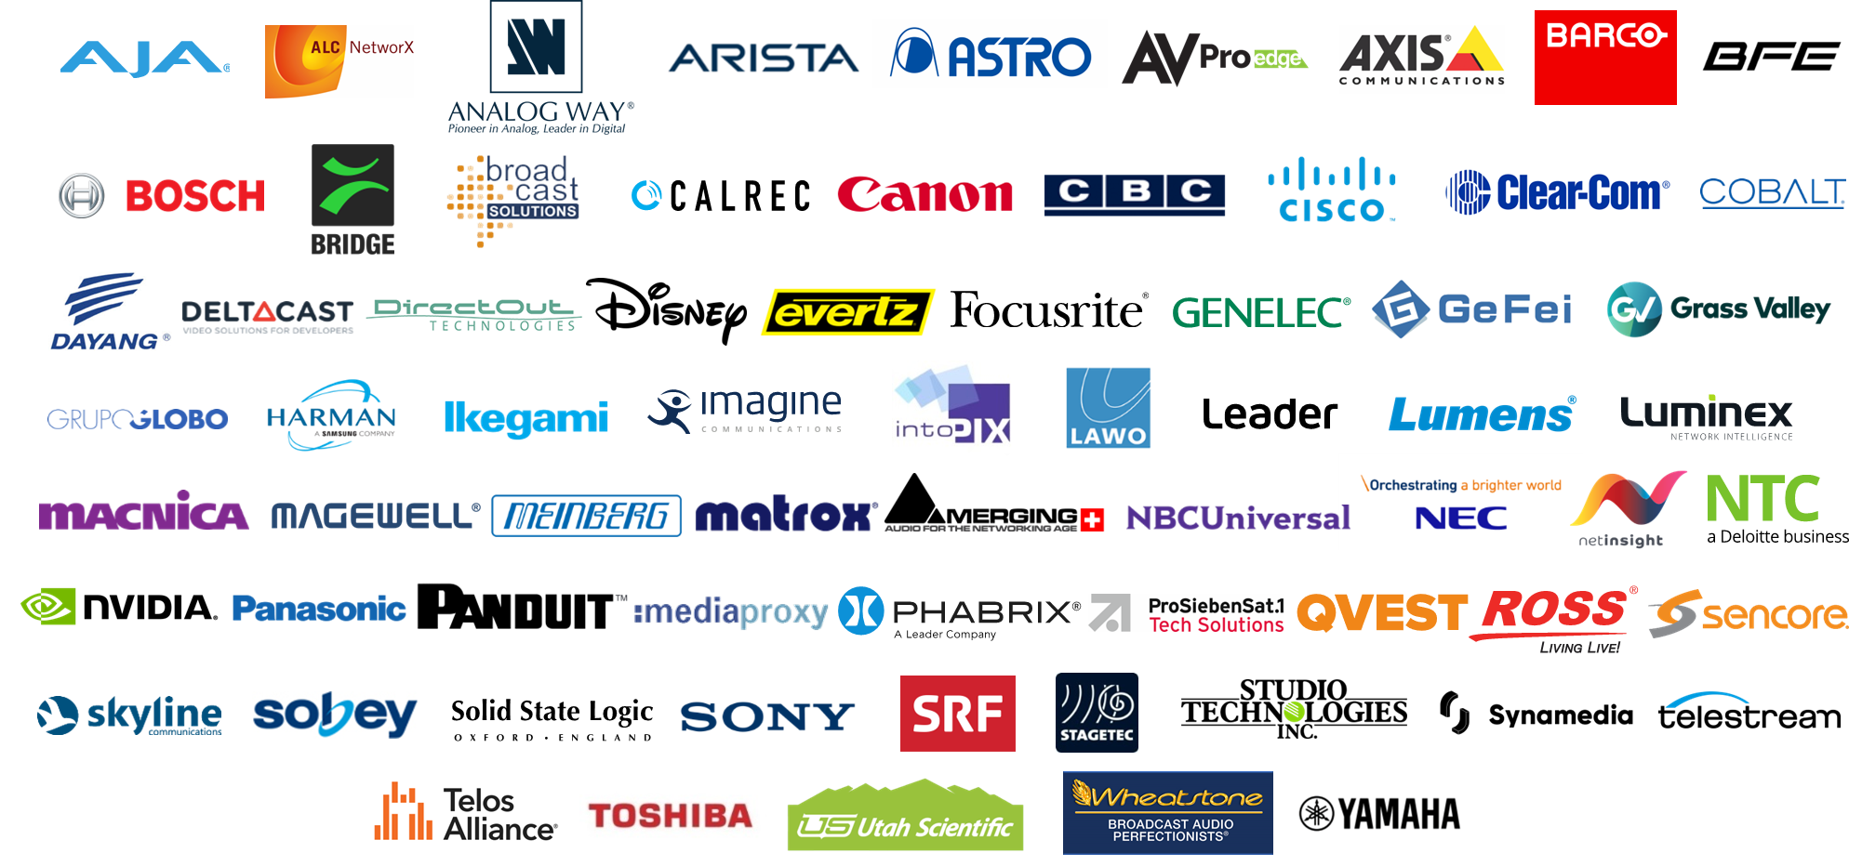
AIMS Members

Slide 4
AIMS Organization
Full Members
Associate Members
Partners
Technical Working Group
Education Working Group
Marketing Working Group
Audio Subgroup
ProAV Subgroup

Slide 5
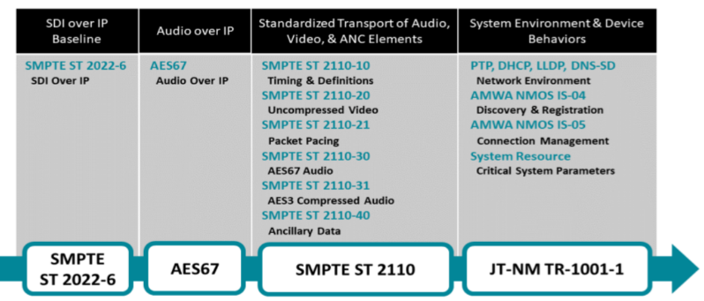
The AIMS Broadcast Roadmap
SMPTE ST 2110-x Stable minor updates coming soon
AMWA IS-04/05 Stable minor updates
JT-NM TR-1001-1 Stable minor update in 2020
System Resource Stable published as AMWA IS-09
AES67 Stable revised (non-breaking) 2018
PTP (IEEE 1588v2) Stable IEEE 1588:2022 (non-breaking)

Slide 6
State of the Standards on the AIMS Broadcast Roadmap
SMPTE ST 2110-x Stable minor updates coming soon
AMWA IS-04/05 Stable minor updates
JT-NM TR-1001-1 Stable minor update in 2020
System Resource Stable published as AMWA IS-09
AES67 Stable revised (non-breaking) 2018
PTP (IEEE 1588v2) Stable IEEE 1588:2022 (non-breaking)
AMWA IS-08 Stable
VSF TR-07 new
VSF TR-08 new
VSF TR-10-x (IPMX) new

Slide 7
Audio Subgroup
Purpose
Provide a forum within AIMS to focus on issues and activities that are specifically related to audio
AES67 Revision
Audio devices in IPMX
Audio content in Education Library
Upcoming Activity
Partnering with the AES on a “Media over IP” Pavilion at the AES NY Convention in October
This convention will run in parallel with NAB NY (sharing the same exhibition show floor)
Presentation Theater will be the focus of the pavilion
Exhibit Stations will be available, allowing companies to have a presence at the convention for a very reasonable cost
Exhibit Station exhibitors will be allocated presentation slots in the theater

Slide 8
AIMS Initiatives – Fostering Adoption
Notes:
12 Press Releases (Plus releases originating from Lumens and Barco)
202+ Editorial Mentions in global B2B publications
27+ were contributed articles / interviews

Slide 9
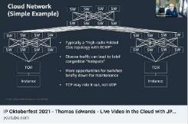
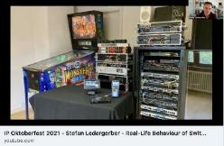
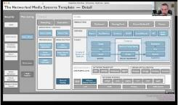
AIMS Initiatives – Fostering Adoption
Live Video Production in the Cloud
Real-Live Behavior of Switches
IP Systems – The Big Picture
IPMX: The Emerging AV over IP Open Standard

Slide 10
Education Working Group
Launched in early 2022
Efforts to date have been to make existing content more accessible
Presentations from past events including IP Showcase, AES Conferences, IP Oktoberfest, Techfest and Summer Sessions
Two major efforts ongoing in the group:
Metadata for improved searching and categorization
Key metadata defined
Populating all content has had first pass, but could use enriching over time
Define the presentation and user experience on the AIMS website for users
Definition is coming together
Next steps: Engage with web designers to determine how to realize the vision

Slide 11
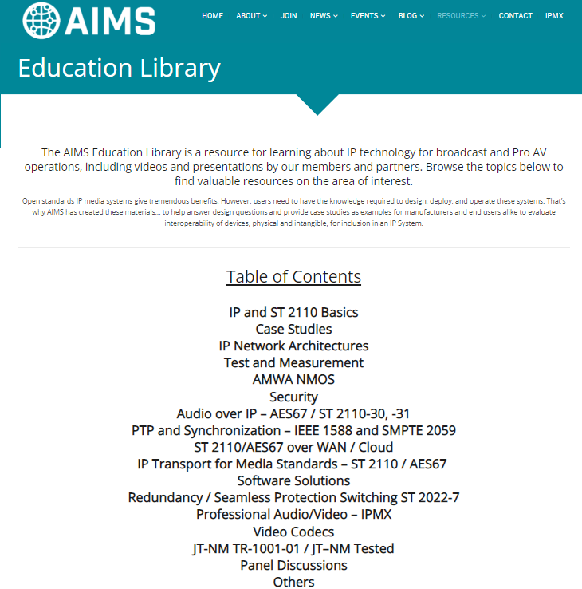
EWG on the Website (www.aimsalliance.org)

Slide 12
Momentum for Open Standards AV over IP
If you’re in AV, IPMX is an acronym you need to know.
IPMX offers a range of advantages to professional A/V…
The excitement around IPMX is everywhere…
Multi-vendor Interop at InfoComm 2022
(June 2022)
AIMS Pro AV Working Group dramatically increases promotion
VSF and AMWA become involved in new technical specifications
More general acceptance of the need for IPMX by InfoComm 2021 attendees and exhibitors
(Oct 2021)
IPMX brand launched at ISE 2020 Show
(Feb 2020)
2018
Pro AV WG Starts
ST2110 + NMOS + additional functions
[IPMX] will be transformative.
joined VSF
(Feb 2022)
joined AIMS
(June 2020)
joined AIMS
(Mar, Aug 2021)
[IPMX] will give AV integrators virtually limitless freedom to customize AV-over-IP systems…
joined AIMS
(Apr 2022)

Slide 13
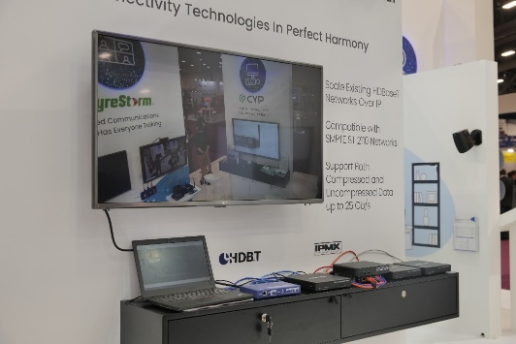
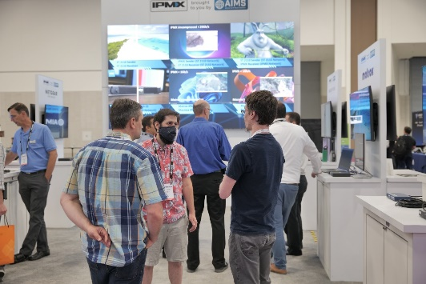
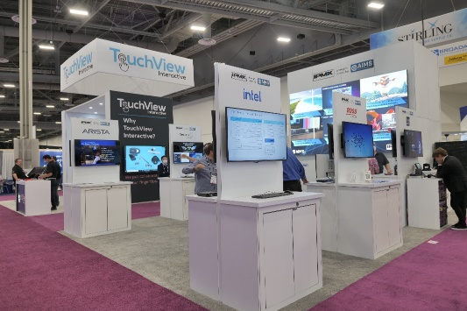
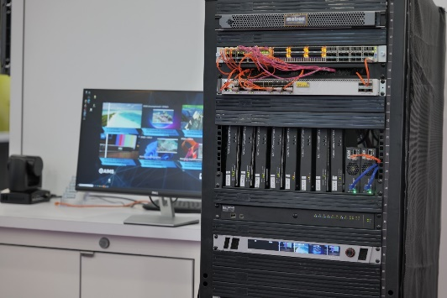
InfoComm 2022 12 company interop of ST 2110 and IPMX standards-based equipment

Slide 14
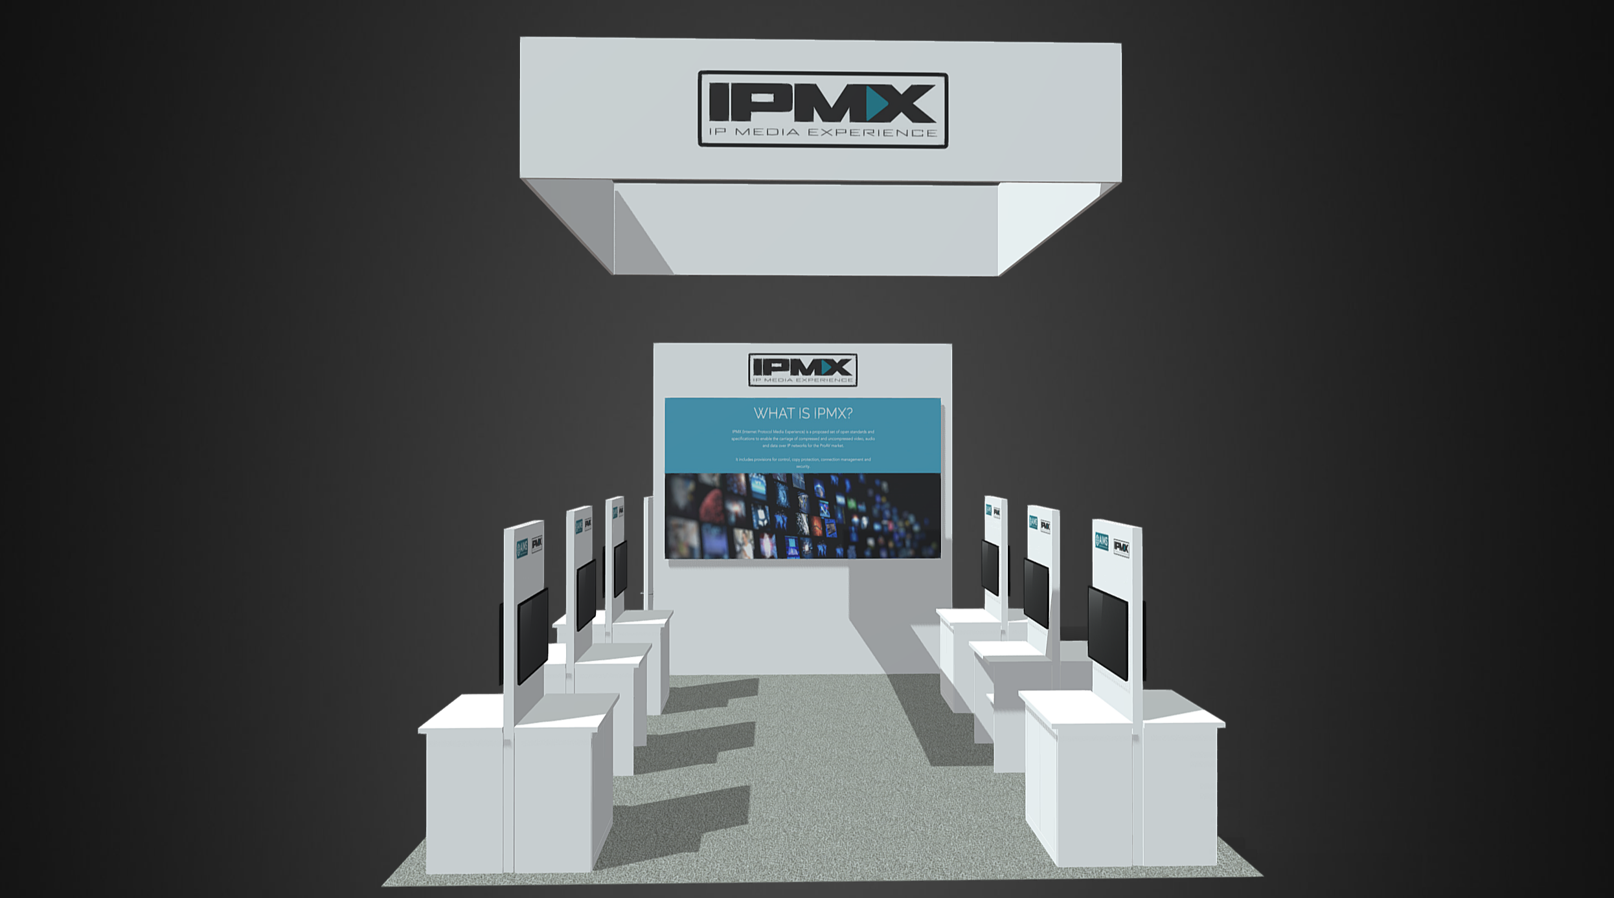
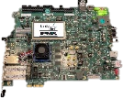
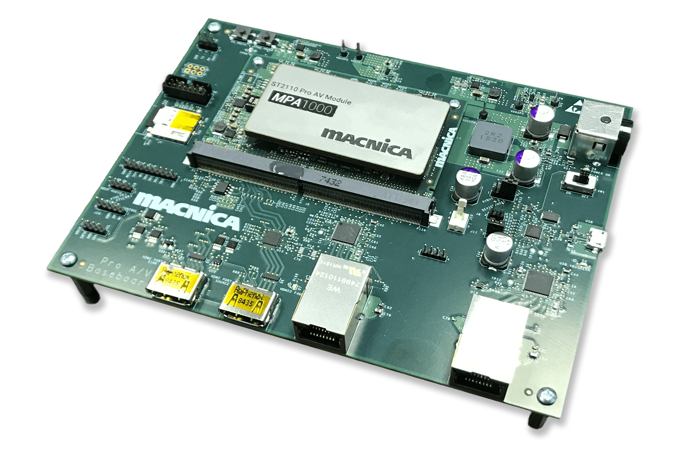
⓫
Developer platforms receiving and displaying content from other nodes in demo
❺
Uncompressed and compressed IPMX encoding and decoding equipment
❿
Managed switches running all the ST 2110 media in this demonstration
❹
Equipment for converting between different protocols to/from IPMX
Gateways
⓬
Managed switches running all the compressed
media in this demonstration
❻
Directview LED wall processors receiving native IP content from the other partners in the booth
❾
JPEG-XS IP provider decoding streams from this demonstration in software
❸
Management System and UX leveraging NMOS and SMPTE standards
❾
❸
❽
❷
Software and hardware platforms encoding and decoding IPMX in demo
❼
❶
Transmitting and receiving content being used in both ST 2110 and IPMX networks
❽
⓬
❻
❷
⓫
❺
❿
❹
❼
Managed switches running all the uncompressed IPMX media in this demonstration
❶
Live transcoding of
ST 2110 uncompressed to ST 2110 JPEG-XS

Slide 15
AIMS InfoComm 2022 IPMX Demo
New (first public showing) IPMX progress items:
Transferring ST 2110 (on PTP network) content to IPMX nodes (network with or without PTP)
(Example: Stadium/arena content from broadcast room feeding network television + jumbotron, also shared “natively” (no conversion to baseband) with all IPMX stations throughout the stadium/arena (digital signage, private booths, etc.)
Opposite: IPMX network content ➔ ST 2110 network nodes
(Example: Increasing new experiences in broadcast by bringing “AV” nodes into the broadcast room. For example: cameras in stadium/arena celebrity private lounges available with nearly no latency using native AV to broadcast network compatibility)
IPMX hardware and software senders and receivers all sharing content “at performance”
More emerging IPMX⬄ Pro AV gateways; will be showing IPMX ⬄ HDBaseT gateways at InfoComm
<1 millisecond glass-to-glass latency live media over IP
First real suite of standards and technical recommendations across “multiple” video workflows
(Uncompressed and Compressed)
Developer platforms (Macnica, Nextera, more …)
Processor support (AMD, Intel, etc.)

Slide 16
What’s Next?
IPMX (VSF TR-10)
NAB NY
New EWG content and UI at aimsalliance.org

