Slide 1
JPEG XS - Wrapping It Up in RTP
Thomas Edwards AWS

Slide 2
JPEG XS: Low-complexity, low-latency, high quality codec
“JPEG” joint working group of International Standardization Organization (ISO) & International Electrotechnical Commission (IEC)
Standardized as ISO/IEC 21122
It’s neither JPEG nor JPEG 2000
“XS” = “eXtra speed” & “eXtra small”
Wavelet-based codec
Low complexity – 4K 60p on i7 in real time
Royalty required for use
Note there is no dash in the name of JPEG XS!

Slide 3
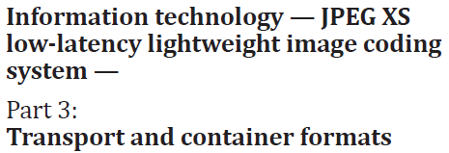
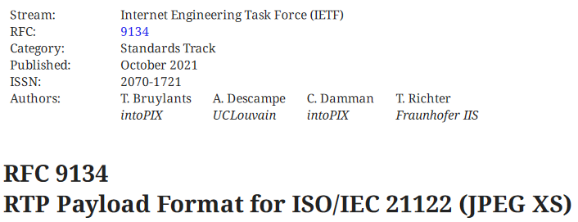
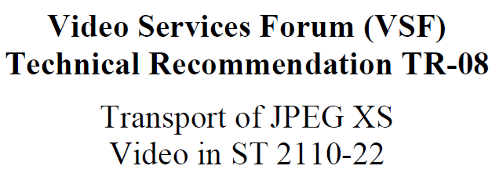
4 Key Defining Documents for JPEG XS in RTP
ISO/IEC 21122-3
Specifies metadata “boxes”
IETF RFC 9134
RTP payload format for JPEG XS
SMPTE ST 2110-22
How CBR compressed video works in 2110 systems
VSF TR-08
JPEG XS constraints for television signal interoperability

Slide 4
Important Vocabulary!
ADU: Application Data Unit, spread across one or more…
Packetization units, in “codestream packetization mode”, a…
JPEG XS picture segment, made up of:
Video Support Box
Color Support Box
JPEG XS codestream of one field/frame
VSF TR-08 only allows codestream packetization mode
I’ll skip slice packetization mode…

Slide 5
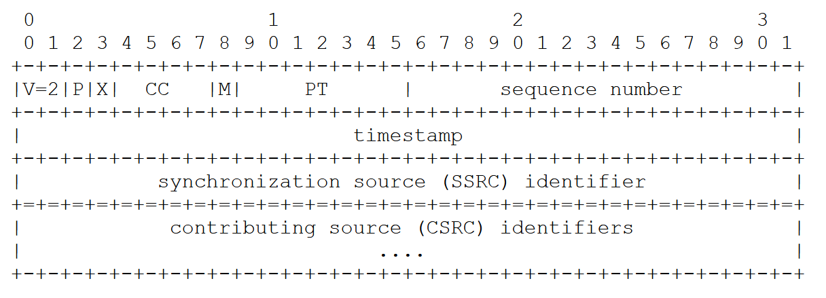
RFC 9134: RTP Header – no surprises
Version, Padding, eXtension, CSRC count (CC), sequence number, synchronization source & contributing source identifiers as per RFC 3550
Marker Bit – last packet of field/frame
Timestamp – 90 kHz

Slide 6
RFC 9134: JPEG XS Payload Header
Transmission mode: 1=sequentially, 0=may be out of order
pacKetization mode: 0=codestream, 1=slice
Last: last packet of a packetization unit (in codestream mode, end of field/frame, and same as Marker bit)
Interlaced Information: 00=progressive, 10=first field, 11=second field
Frame counter (modulo 32)
Slice and Extended Packet (SEP) counter: resets when Packet counter resets & increments by 1 when Packet counter overruns
Packet counter: Counts packets in packetization unit (for codestream mode, in the JPEG XS picture segment), modulo 2048

Slide 7
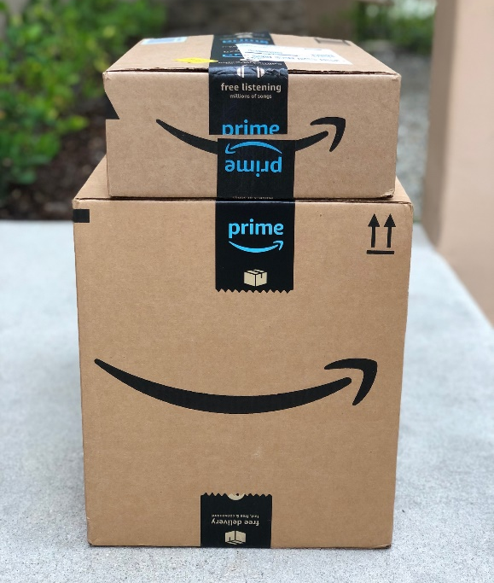
ISO/IEC 21122-3: Boxes
“Derived from” atoms from ISO/IEC 14496-12 ISOBMFF / QuickTime, but specifically defined for JPEG XS
LBox: 4 byte length field
TBox: 4 byte box type
'jpvs' (0x6A70 7673): JPEG XS Video Support Box
'colr' (0x636F 6C72): Color Specification Box
XLBox: 8 byte extended length field (if LBox=1)
DBox: box contents

Slide 8
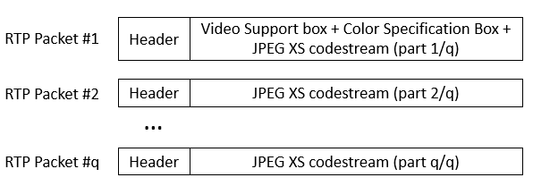
RFC 9134: Payload Data
Video Support (VS) Box
A “superbox”, a box that contains other Boxes
Contains “video information”
e.g. frame rate, field coding, time code, profile/level
Color Specification (CS) Box
e.g., color primaries, transfer characteristics, “full” range

Slide 9
ISO/IEC 21122-3: Video Support Box: mandatory sub-boxes
'jpvi' (0x6A70 7669): JPEG XS Video Information Box
brat [32 bits]: max bitrate
frat [32 bits]: frame rate including interlace mode, numerator, denominator
schar [16 bits]: sample characteristics, bit depth, sampling
tcod [32 bits]: timecode HHMMSSFF
'jxpl' (0x6a78 706c): JPEG XS Profile and Level Box
Ppig [16 bits]: profile
Plev [16 bits]: level

Slide 10
ISO/IEC 21122-3: Video Support Box: optional sub-boxes
'bmdm' (0x626d 646d): Buffer Model Description Box
Tmbd: buffer model from ISO/IEC 21122-2
Either the buffer model with limited transmission latency
…or full use of decoder smoothing buffer (variable transmission latency)
# coefficient groups of horizontal & vertical blanking periods
'dmon' (0x646d 6f6e): Mastering Display Metadata Box
SMPTE ST 2086 metadata
MCLL, MFALL as per CTA 861-G
'jptp’ (0x646d7370): JPEG XS Video Transport Parameter box
Suggestions to decoder: # slices assigned to processing units, #parallel decoding units, size of packet reordering buffer

Slide 11
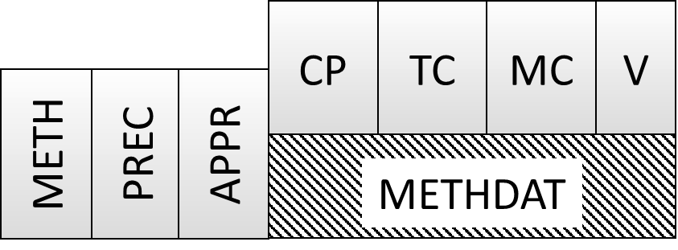
ISO/IEC 21122-3: Color Specification Box
'colr' (0x636F 6C72): Color Specification Box
METH [8 bits]: 5=Coding Independent Code Points (CICP) of Rec. ITU-T H.273
PREC [8 bits]: Precedence, undefined, should =0
APPR [8 bits]: Colorspace approximation, currently =0
METHDAT: Method data for CICP
CP [16 bits]: Color primaries
TC [16 bits]: Transfer characteristics
MC [16 bits]: Matrix coefficients
V [8 bits]: Video Full Range Flag (1=full range)

Slide 12
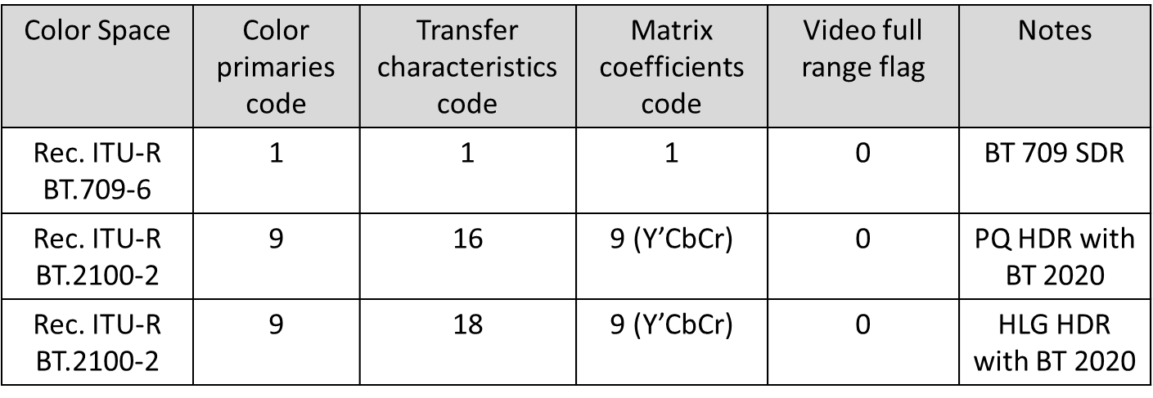
Color Specification Box Commonly Used METHDAT (from VSF TR-08)

Slide 13
ISO/IEC 21122-1: JPEG XS Codestream
Markers Identify structural parts of codestream
Marker segments Markers followed by length field and data parameters
Entropy coded data Wavelet coefficients that have been entropy coded
Precincts Entropy coded data of wavelet coefficients contributing to spatial region of the image
Slices integral number of precincts over the full width of the image.
Image
Precinct
Slice

Slide 14
JPEG XS Codestream Syntax
Syntax Element | Syntax Type | Code (if marker)
Start of Codestream (SOC) | marker | 0xff10
Capability Marker | marker segment | 0xff50
Picture Header | marker segment | 0xff12
Component Table | marker segment | 0xff13
Weights Table | marker segment | 0xff14
Extension Marker | marker segment | 0xff15
Loop over Slices {
Slice Header | marker segment | 0xff20
Loop over Precincts {
Precinct Header | entropy coded data
Loop over Packets {
Packet Header | entropy coded data
Packet Body } | entropy coded data
Fill()
}} End of Codesteam (EOC) | marker | 0xff11

Slide 15
JPEG XS & ST 2110
ST 2110
Emmy Award Winning
ST 2110-22
Use CBR RTP Payload defined by IETF
®
+
=
ST 2110-22 with JPEG XS
RFC 9134
RTP Payload Format for ISO/IEC 21122
Notes:
2110-22 has a few requirements on CBR codec: constant number of bytes & packets per frame.

Slide 16
VSF TR-08 Constraints
Codestream Packetization Mode
JPEG XS profile “High444.12”
5 horizontal & 2 vertical wavelet transforms
Only uniform quantizer
4 bpp min & 1.5 bpp max compression
# bytes in Payload Data multiple of 8 bytes
Senders/receivers must support “configurations”
Combinations of Conformance Level & Capability Set
Includes audio & video
Intra-facility, interfacility, and intra-campus IPMX Capability Sets

Slide 17
Important Note
RFC 9134 took 3 ½ years to develop
Internet-draft versions significantly different than RFC
Fielded devices may use -0 or -3 version of I-D

Slide 18
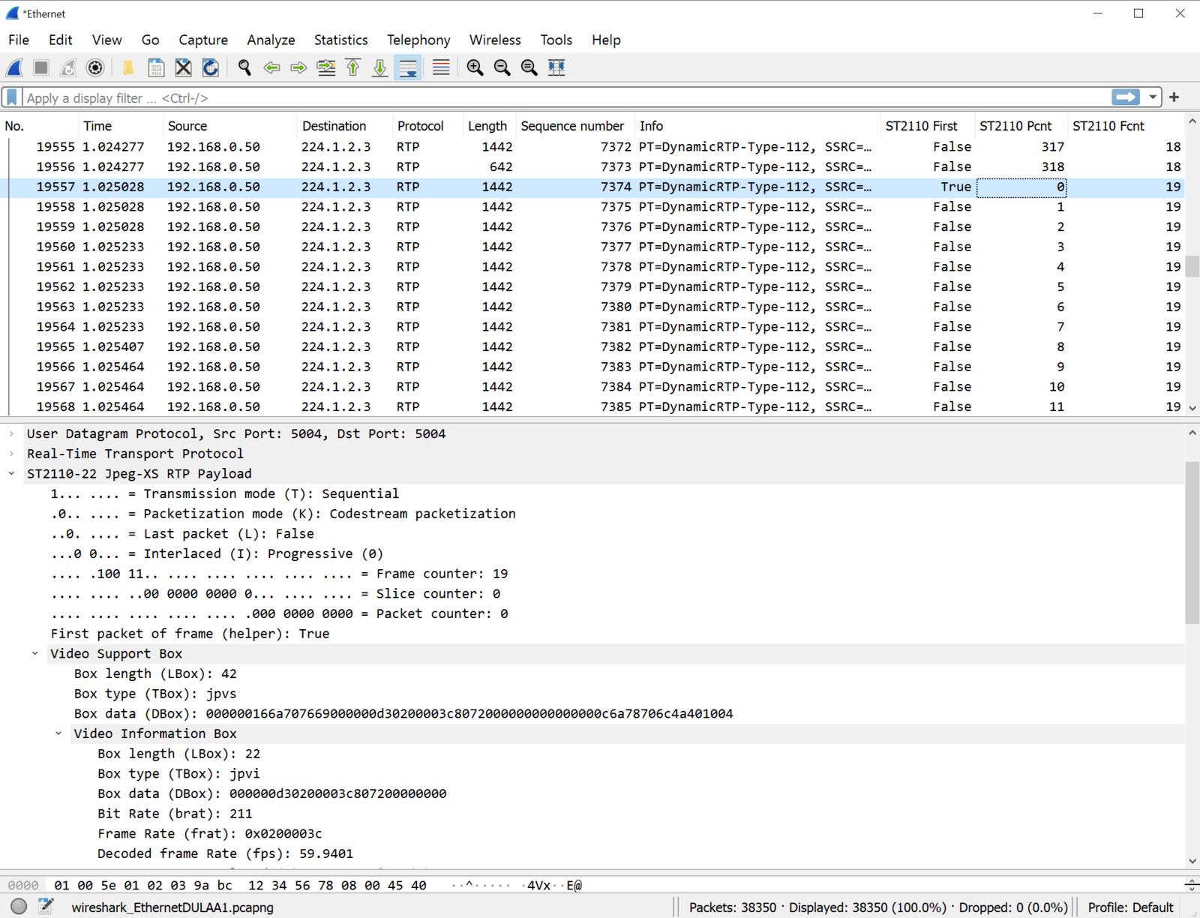
JPEG XS RTP Wireshark Dissectors from intoPIX
Available for free from: https://www.intopix.com/blogs/post/Deep-dive-into-SMPTE-ST2110-22-with-Wireshark-Dissector

Slide 19
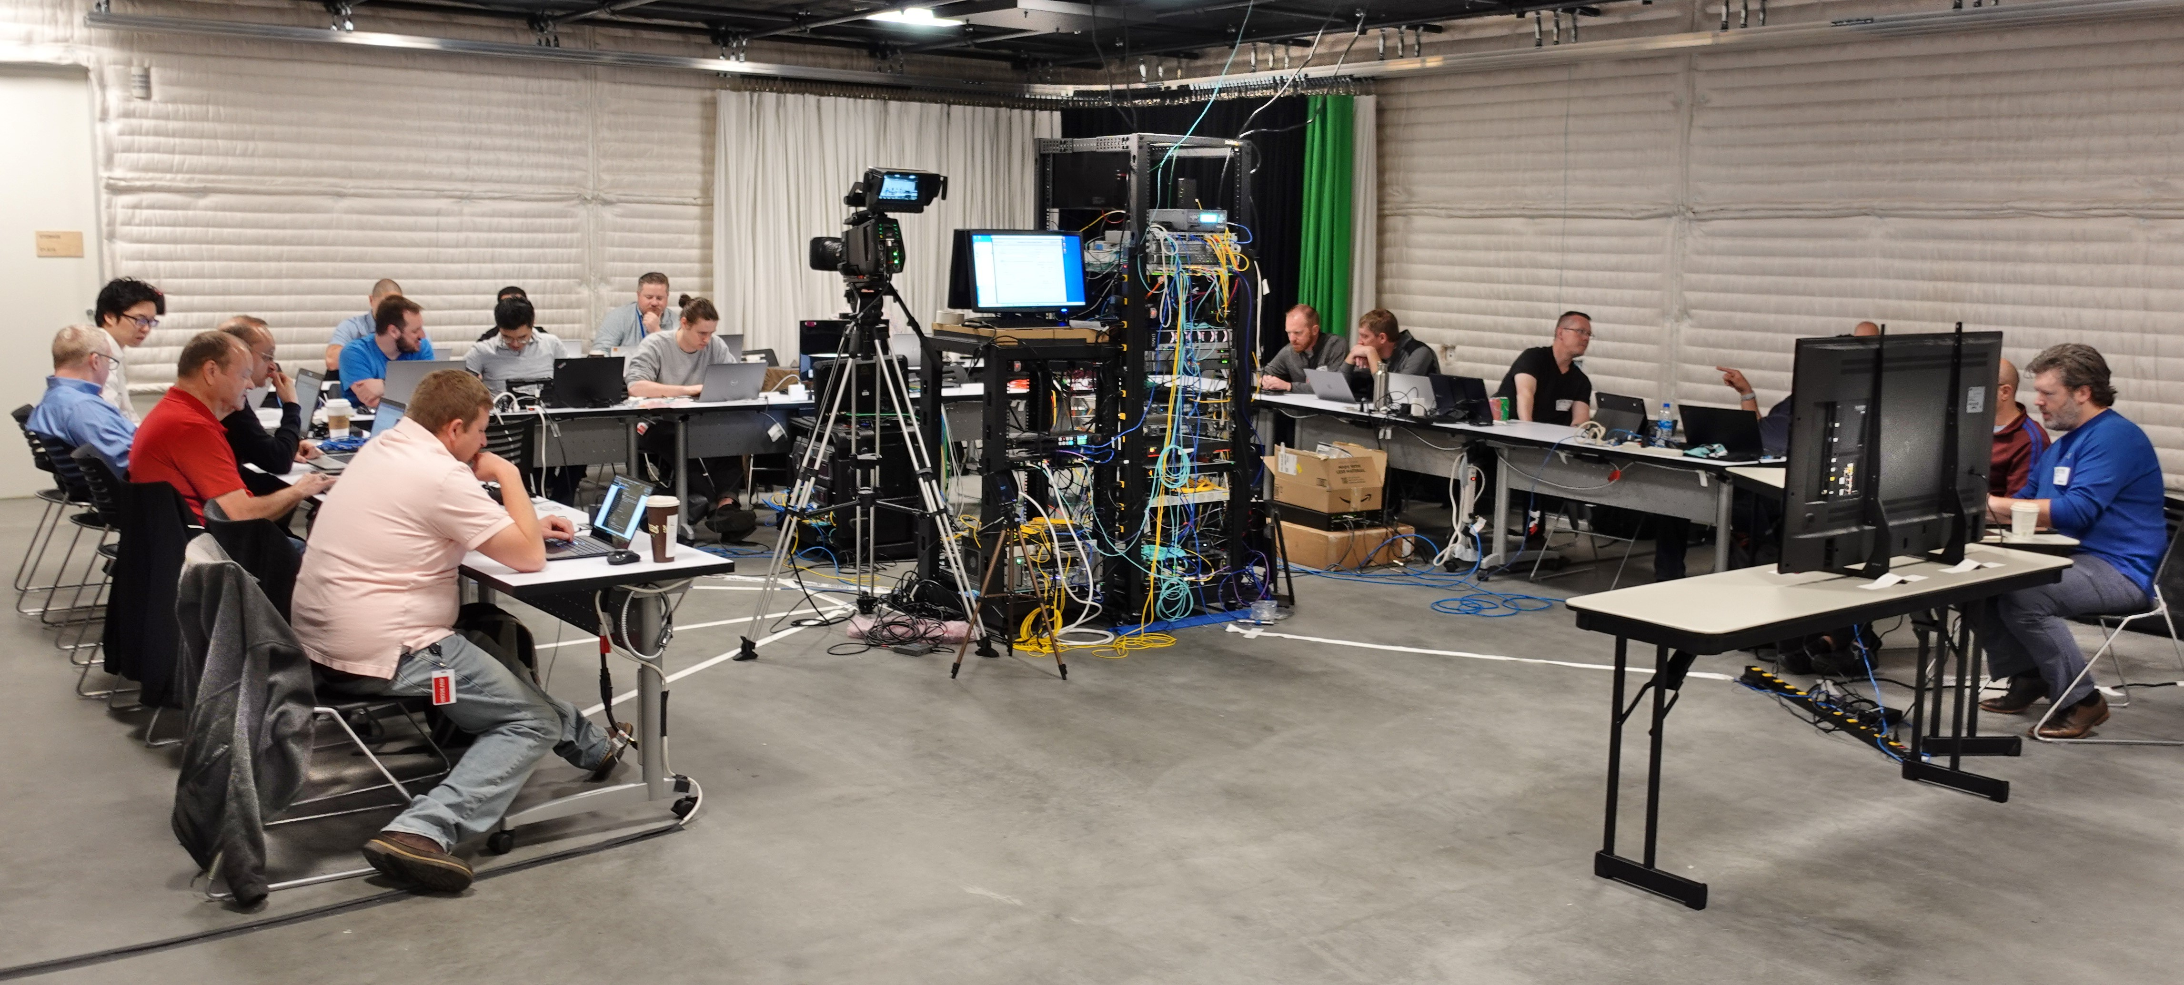
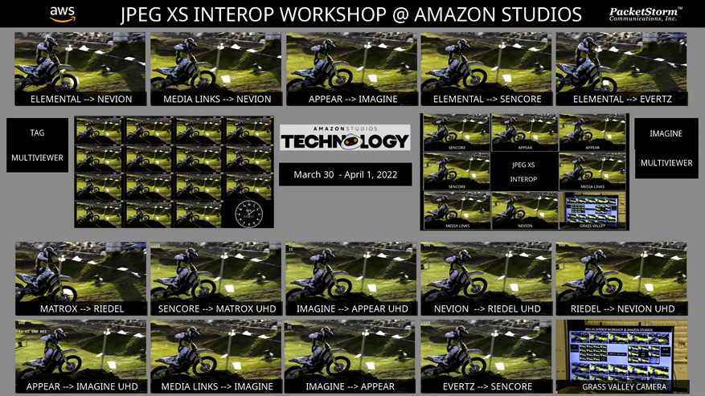
JPEG XS Interop @ Amazon Studios
March 31/April 1, 2022
11 vendors, >200 different interoperation tests
Encoders, decoders, multiviewers, camera
On-prem & AWS Elemental cloud
Interlaced HD, progressive HD, and UHD video stream formats.
Appear, Evertz, Imagine Communications, Grass Valley, Matrox, Media Links, Nevion, Riedel, Sencore, TAGvs

Slide 20
What about discovery and control?
NMOS is the registration and discovery and connection management layer for many ST 2110 systems
NMOS easily works with new formats, not just uncompressed video/audio
The AMWA has a final draft of BCP-006-01 “NMOS With JPEG XS” – https://specs.amwa.tv/bcp-006-01
BCP-006-01 specifies how the capabilities of JPEG XS Media Nodes are described in IS-04 and IS-05 to ensure Controllers can identify and connect compatible senders and receivers
Final step before elevation to AMWA Specification is to demonstrate interop and an automated test suite, targeting Q4 2022
New participants welcome to join in! Contact garethsb@nvidia.com

Slide 21
Conclusions
JPEG XS – software friendly, high-quality, low-latency codec, great for on-prem or the cloud
Several different documents must be read to understand the carriage of JPEG XS over RTP/IP
Interop event proved multi-vendor interoperation of JPEG XS
Broadcast industry is now actively using JPEG XS over IP, and we’ve got Wireshark dissectors to help!
Note there is no dash in the name of JPEG XS! JPEG-XS

Slide 22
Any Questions?

