Slide 1
Leveraging Open Caching for Last-Mile Delivery
Contributors
Sanjay Mishra,
Jeff Budney and ErinRose Widner
Verizon Business Group
September 2022

Slide 2
Abstract
As media companies focus on growing their Direct to Consumer (D2C) businesses, the ecosystem that enables content delivery over IP-based networks continues to evolve and become even more critical.
In order to gain efficiencies in the process, media technology providers want to better leverage each component in the content delivery path.
The new Open Caching standard enables a move away from proprietary systems, while still supporting an environment that leverages content delivery networks, last mile providers and streaming technologies that bring content closer to the consumer.

Slide 3
Media Consumer Landscape

Slide 4
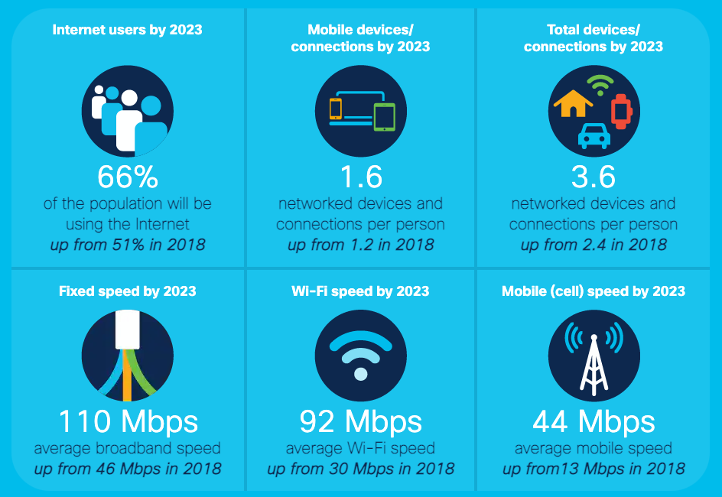
2023 Global Internet Traffic Predictions
5.3 billion Internet users, up from 3.9 billion in 2018, an increase from 51% to 66% resulting in two-thirds of the world population with access to the Internet. [1]
Devices and connections are growing faster (10 percent CAGR) than both the population (1.0 percent CAGR) and the Internet users (6 percent CAGR).[1]
[1]

Slide 5
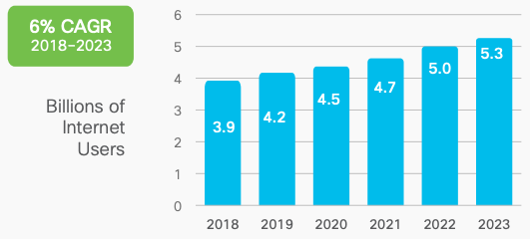
Over 80%
of Internet traffic is
video viewing[2]
[1]

Slide 6
Contributing Factors to Internet Video Consumption
Improved access to the Internet
Improved connectivity type (broadband speed) for both wireline (Fiber and DOCSIS over Cable) and fixed wireless access even with 4G–and now 5G–have improved overall broadband speeds.
The global average broadband speed continues to grow and will more than double from 2018 to 2023, from 45.9 Mbps to 110.4 Mbps.
[1]

Slide 7
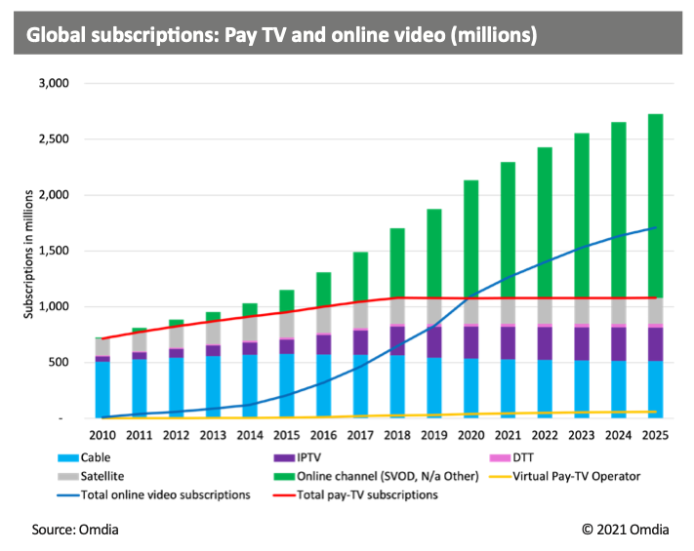
VOD & Subscription Landscape
According to Nielsen as of August 2022, streaming viewership surpassed Cable TV for the first time.
Global pay-TV subscriptions are expected to stay stable—at over 1 billion subscriptions by 2025 [4}

Slide 8
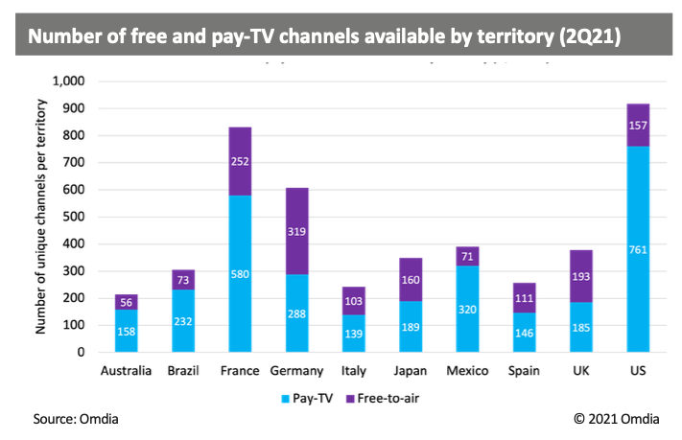
SVOD Provider Growth & Customer Demands
Consumers are likely to have multiple paid SVOD subscription services, so the key in has traditionally been for SVOD providers is to invest in creating even more original content to help reduce churn and add new subscribers.
SVOD is also expanding their markets and content internationally in order to continue to grow and attain new customers.
Given substantial opportunities for growing their revenues but in a very crowded SVOD market, it is imperative for the SVOD providers to be able to give their subscribers a reason to stay.
With all these factors, SVODs must determine what will help provide the best user experience, both in terms of content available and the user’s ability to seamlessly access the content (e.g., fast video start-times, zero or near zero video playback failures, zero or near zero buffering, or higher bit-rate).
[4]

Slide 9
Content Delivery Evolution: Open Caching

Slide 10
The Content Delivery Evolution & Streaming Video Technology Alliance (SVA)
Content Delivery Networks (CDNs) have provided a far-reaching network for content providers to deliver content to their subscribers, and has become the standard delivery model. But according to The Streaming Video Technology Alliance, ISPs also have a place in being part of the delivery value chain as we move forward. [7]
SVTA is an industry forum founded in 2014 open to all within the online video value chain, focused on the ecosystem, architecture, technologies, and best practices needed to support the future of video facilitates the development of solutions to solve technical challenges so consumers can experience the best possible viewing experience, anywhere in the world, on any device.

Slide 11
Streaming Video Technology Alliance: Open Caching Working Group
According to a previously published white paper by the Streaming Video Alliance:
“If all the participants in the distribution chain—CPs, CDNs, and ISPs—continue to work independently, the industry will never resolve the scale and quality issues plaguing widespread adoption of streaming video. To truly address the challenges, CPs, CDNs, and ISPs must come together and collaborate to create a new, integrated delivery architecture.
The Streaming Video Alliance has codified such a collaborative approach in the Open Caching Network (OCN). This innovative solution, developed as a series of specifications from the Open Caching Working Group, is an open way that all three constituents can operate seamlessly together. Rather than siloed technologies, the entire ecosystem works together to develop and share information as part of each request to satisfy the ultimate goal—ensure viewers get the best possible streaming video experience.”
Notes:
They identified a critical need for CPs, CDNs and ISPs to collaborate on creating a new integrated delivery architecture to facilitate the best possible streaming video experience, and that’s how the Open Caching Network was developed.

Slide 12
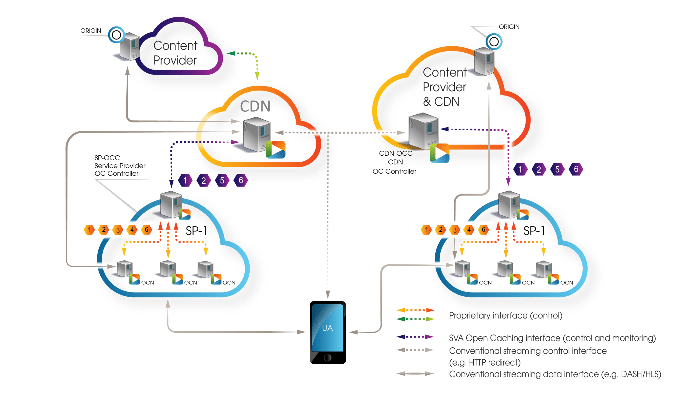
What is the Open Caching Network?
Open Caching Network is an edge caching architecture that allows Content Providers and Content Delivery Networks to utilize caches deployed by Internet Service Providers at the edge of their networks.
In essence, Open Caching allows CP and CDNs to offload content seamlessly in a manner that brings content closer to the user since the Open Caching architecture extends the content delivery infrastructure deep into service provider networks.

Slide 13
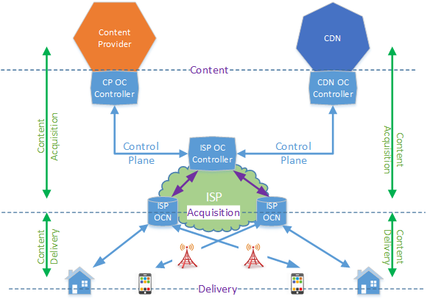
Open Caching Model High-Level View
The Open Caching Working Group identified three core components that together create the open caching network.
Open Caching Node (OCN): A universal multi-tenant cache function deployed and owned by the service provider in close proximity to the users.
Content Provider/CDN Open Cache Controller (CP/CDN OCC): a control function used by delegating Content Provider (CP) and/or a CDN to exchange control plane messages and routing to the open cache resources inside service provider networks.
Service Provider Open Cache Controller/Request Router (SP OCC): a control function used by a service provider with an open caching deployment to interwork with the corresponding instance upstream at the CP/CDN layer and downstream to delegate content to the network of OCNs.

Slide 14
Case Study: Open Caching Delivery

Slide 15
Testing Setup & Scenario
Setup
Verizon’s Fios Network
A Verizon subscriber with a 1Gbps using an Alienware Laptop with an Ethernet connection to the Fios Broadband Home Router
Internet Speed test shows download speed of 947 Mbps and upload speed of 923 Mbps (verizon.com/speedtest/)
Content played from nearest cache serving the Fios User
Content also played from content hosted in the Internet Cloud
Content resolution: 2160p (4K UHD)
Scenario
For this use case, we tested a scenario where two streams of content were delivered to a Fios subscriber.
The source for one stream originated outside of the ISP caches and the second source was the ISP-hosted caches.

Slide 16
Test Methodology & Terminology
The table below shows the Key Performance Indicators (KPI) used for the testing and definition of the KPIs:
Content initially played simultaneously on split screen from the Origin (CDN) and the ISP hosted open caching network
Initially, cache did not have the content and it acquired as it played back to the user
 | Term | Definition
1 | Time to First Byte | The duration from the user or client making a request until the first content byte being received by the client
2 | Bandwidth | The measured client throughput from the last segment downloaded
3 | Download Time | The download time from the last requested segment. From the first byte being received to the last byte
4 | Total Downloaded | The total amount of data downloaded by the client
5 | Response Time | The response time for the last requested segment. From request of segment to receipt of first byte
6 | Buffer | The duration length of the forward buffer
7 | Freeze Events | The count of times where the video had paused for buffering
8 | Bitrate | The bitrate of the representation being downloaded
9 | Jitter | The standard deviation of bitrate values during this session
10 | Quality | The current quality of the video
11 | Dropped FPS | The absolute count of frames dropped by the rendering pipeline since play commenced

Slide 17
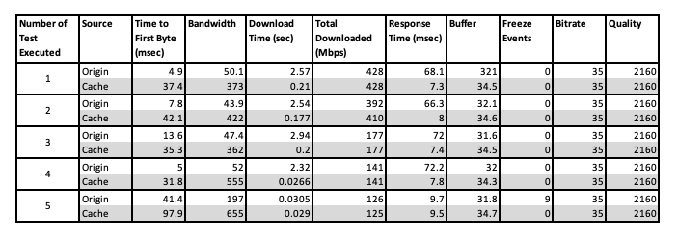
Test Numbers & Observations
This table, shows the results from a series of tests where content was played multiple times (for the purposes of this report, and for brevity of data, the test shows number of times (5), the test was executed).
(Also, note that the content accessed had already been cached)
The test was conducted on a live network. While the results depict real-time network traffic and constraints, they are limited to performance recorded on a given instance.
In the test that was conducted, the Origin server (hosted on Amazon cloud) performed equally well with ISP hosted local cache in terms of maintaining the bit-rate with no freezing events.
However, in other key areas we saw a tremendous improvement when using the local cache. Including the bandwidth being up to 10 times better, and the download time being about two seconds faster in a majority of the tests compared to the Origin server.

Slide 18
Additional Uses
For this paper, we only kept video on-demand as our focus.
However, based on other usage, we see Open Caching performing equally well for live-content and also high bandwidth and low latency applications such as online gaming.
Additionally, Open Caching can be used to deliver non-media content closer to the user such as software downloads, pictures and any kind of content that would be at an origin server or a CDN.

Slide 19
Conclusion
The new Open Caching standard enables a move away from proprietary systems, while still supporting an environment that leverages content delivery networks, last mile providers and streaming technologies that bring content closer to the consumer.
Content stored closer to customers in this manner travels a shorter distance over the network through fewer routers and switches before reaching the customer.
As a result, customers may be able to stream content sooner through fewer network elements with a lower potential for network events that could cause freezing or buffering and improved Quality of Experience for paying customers.
Open Caching is standards-based and encourages collaboration between all constituents in the content delivery pipeline including the content providers, the commercial content delivery networks and the last mile ISP.

Slide 20
ErinRose Widner
Global Business Development, Media & Entertainment, Technology and Studio Innovation
Verizon Business Group
erinrose.widner@verizon.com

Slide 21
References
[1] https://www.cisco.com/c/en/us/solutions/executive-perspectives/annual-internet-report/index.html
[2] https://www.streamingmedia.com/Articles/ReadArticle.aspx?ArticleID=144177
[3] https://www.statista.com/outlook/dmo/digital-media/video-on-demand/united-states
[4] Media & Technology Digest, December 2021 (www.omdia.com)
[5] Global Data, “Subscription Video on Demand Market Trends and Opportunities in the Americas”, June 2021
[6] https://www.mordorintelligence.com/industry-reports/content-delivery-market
[7] https://www.streamingvideoalliance.org/sva-faq/
[8] https://opencaching.streamingvideoalliance.org/
[9] https://datatracker.ietf.org/wg/cdni/about/
[10] https://www.streamingvideoalliance.org/product/optimizing-video-delivery-with-the-open-caching-network/

