Slide 1
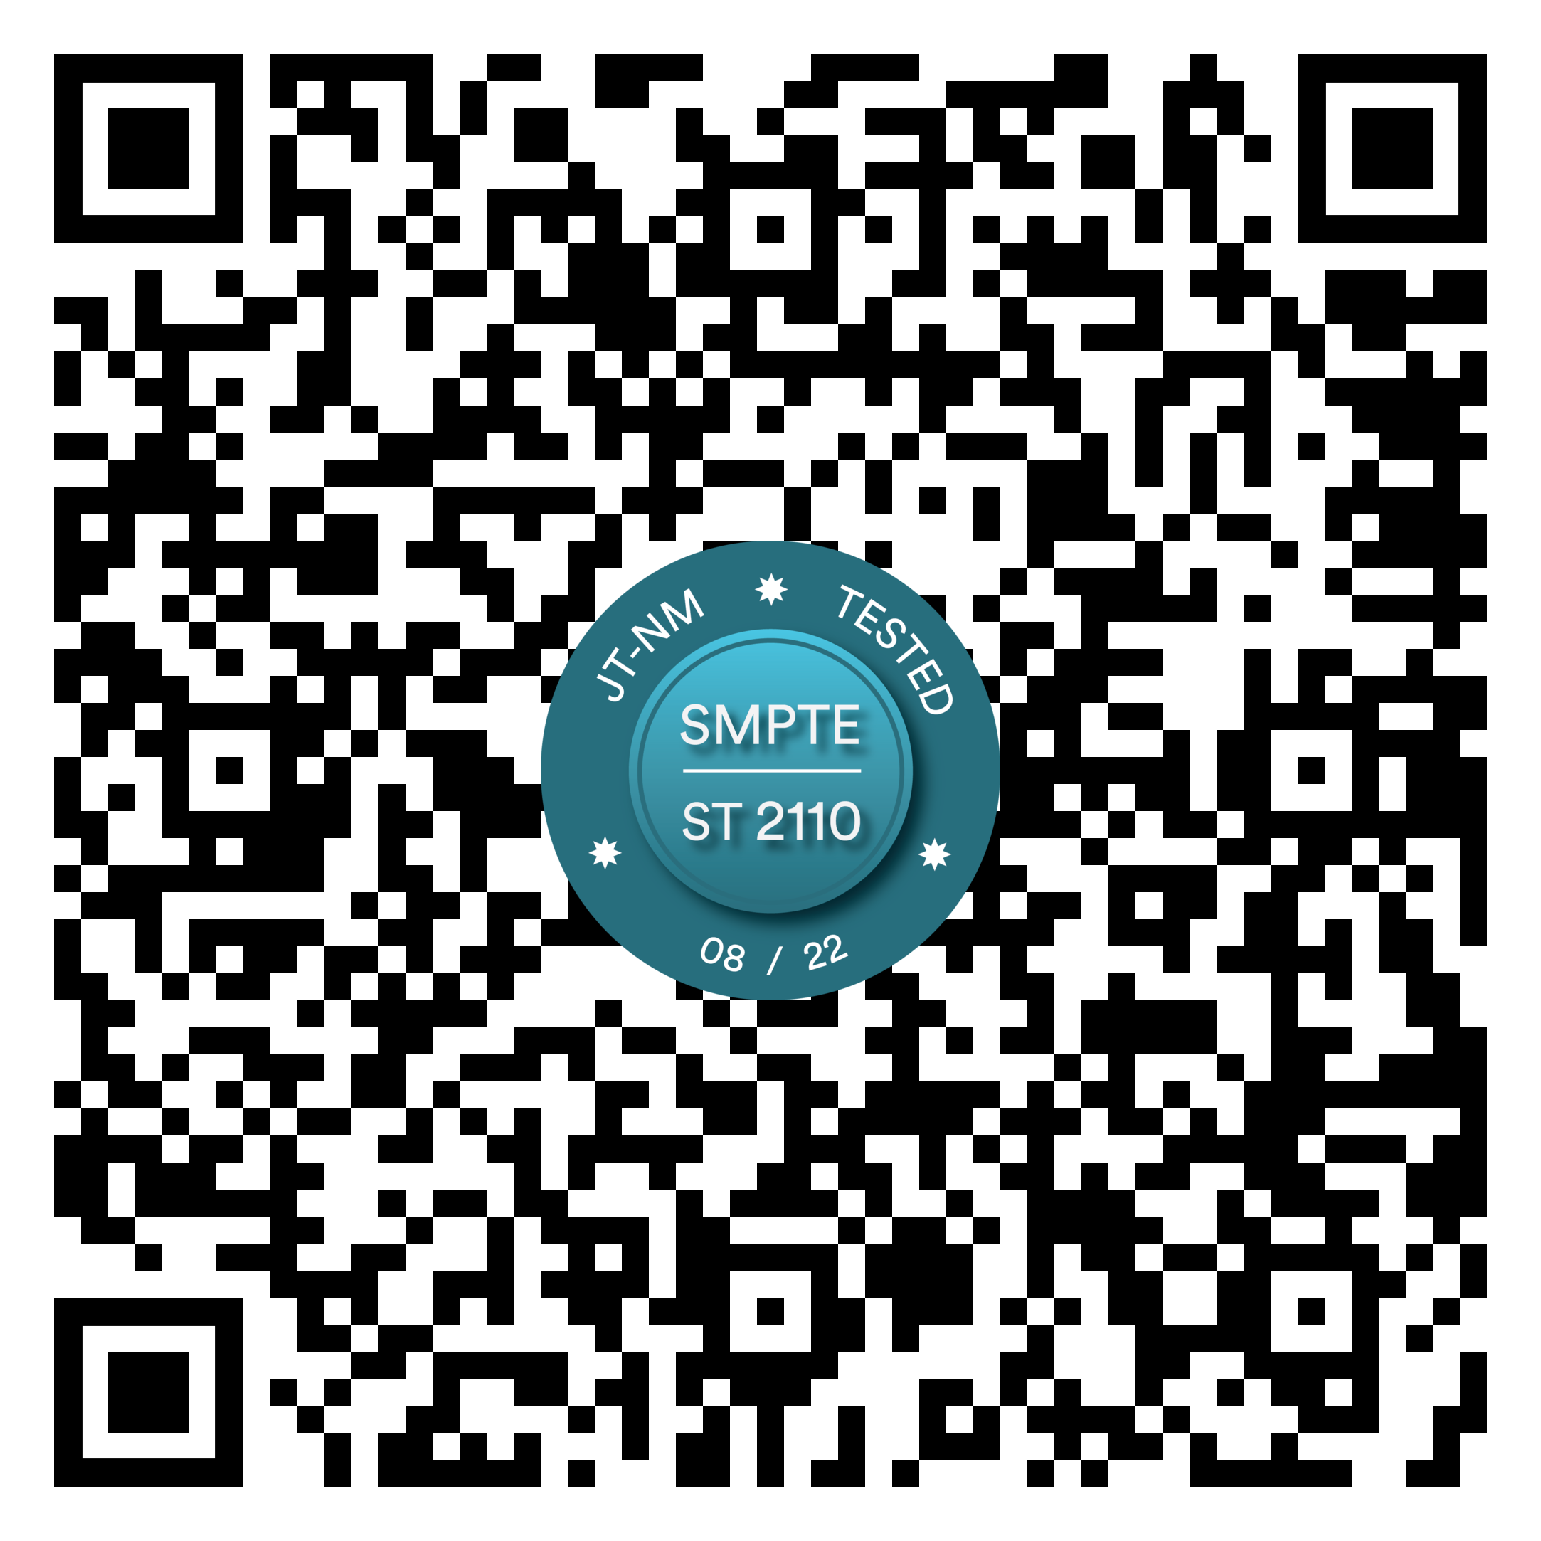
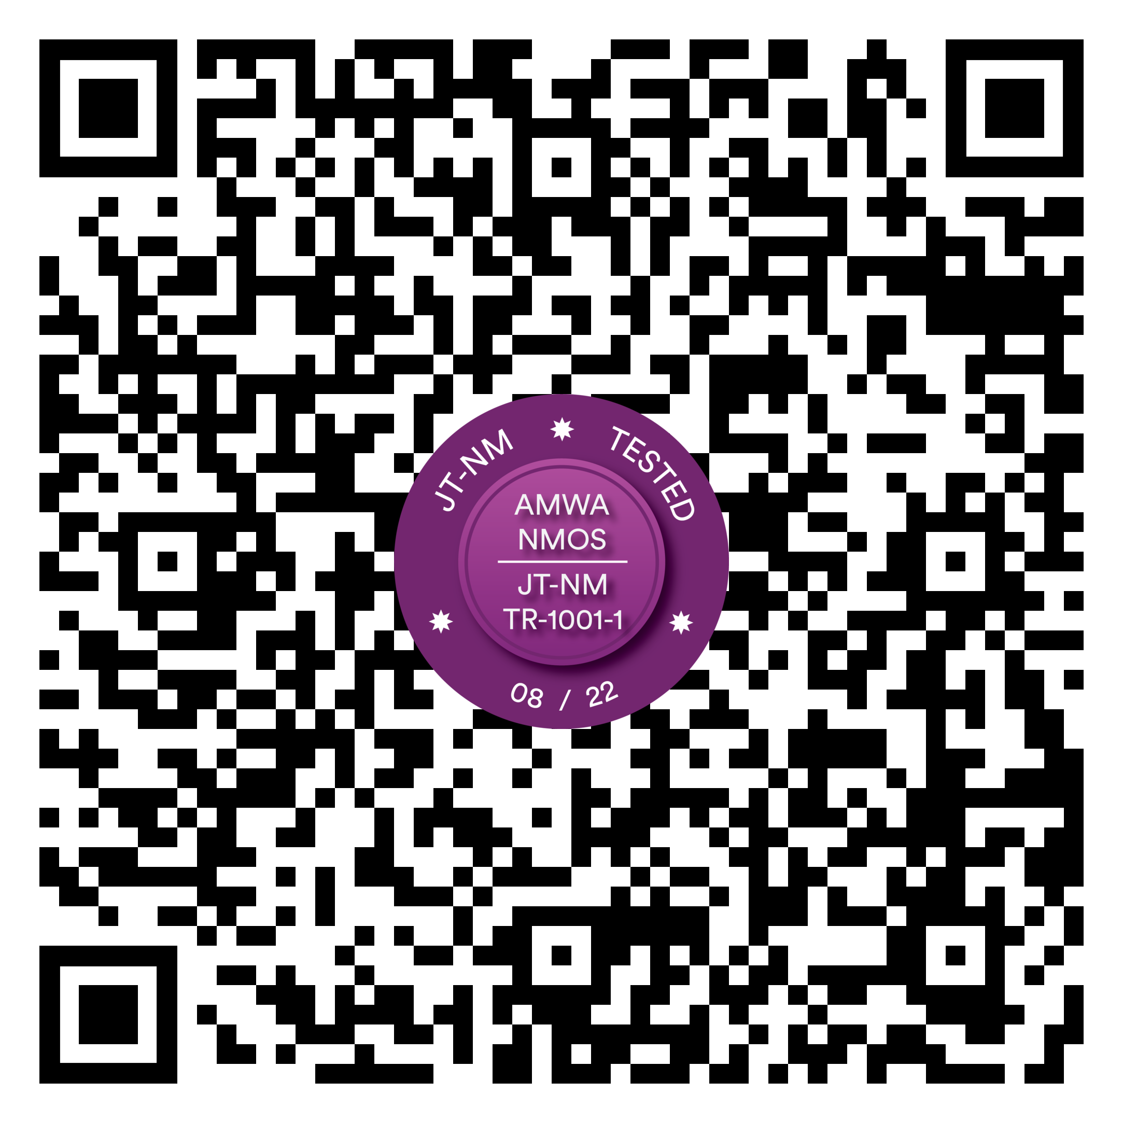
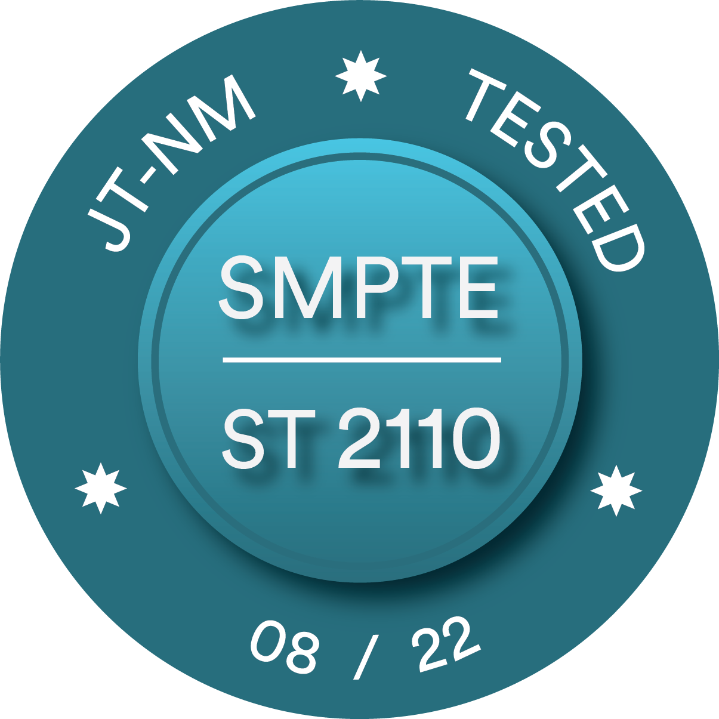
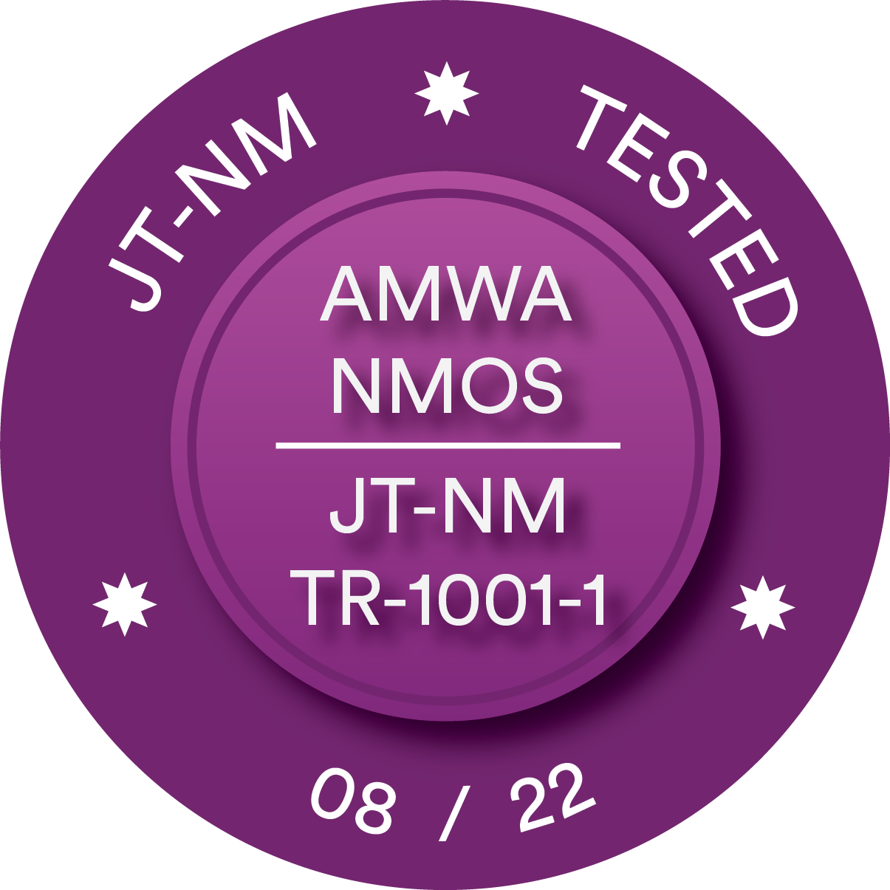
JT-NM TESTED AUGUST 2022
JT-NM Tested Board Report
IP Media Equipment Testing For Interoperable Future

Slide 2
CONTENT
What is JT-NM Tested?
What did we test and why?
Test plans and tools
Network and Infrastructure
Findings and results
Conclusions

Slide 3
JT-NM Tested Program – What is it?
The JT-NM Tested program offers documented insight into how vendor equipment conforms to specific SMPTE standards and AMWA NMOS specifications.
Vendors who meet the testing criteria will have the opportunity to display badges and make public statements about their participation.
The JT-NM Tested Catalog lists vendor results along with a detailed test plan.
Anyone with the equipment listed in the test plan may execute the tests which were administered by the JT-NM test team, and you are encouraged to do so.
It is important to note that the JT-NM Tested program is not a certification program; rather, it is a snapshot in time of how vendor equipment conforms to key parts of SMPTE standards and AMWA NMOS specifications.

Slide 4
JT-NM Tested Program – What did we test?
3 main test tracks:
Data plane: Network access and SMPTE ST 2110 behaviour (curated by EBU and VRT)
Control plane: AMWA NMOS and JT-NM TR-1001-1 behavior, including NMOS registries and controllers (curated by EBU and CBC/Radio Canada)
Cybersecurity Vulnerability Assessment (curated by EBU and VRT)

Slide 5
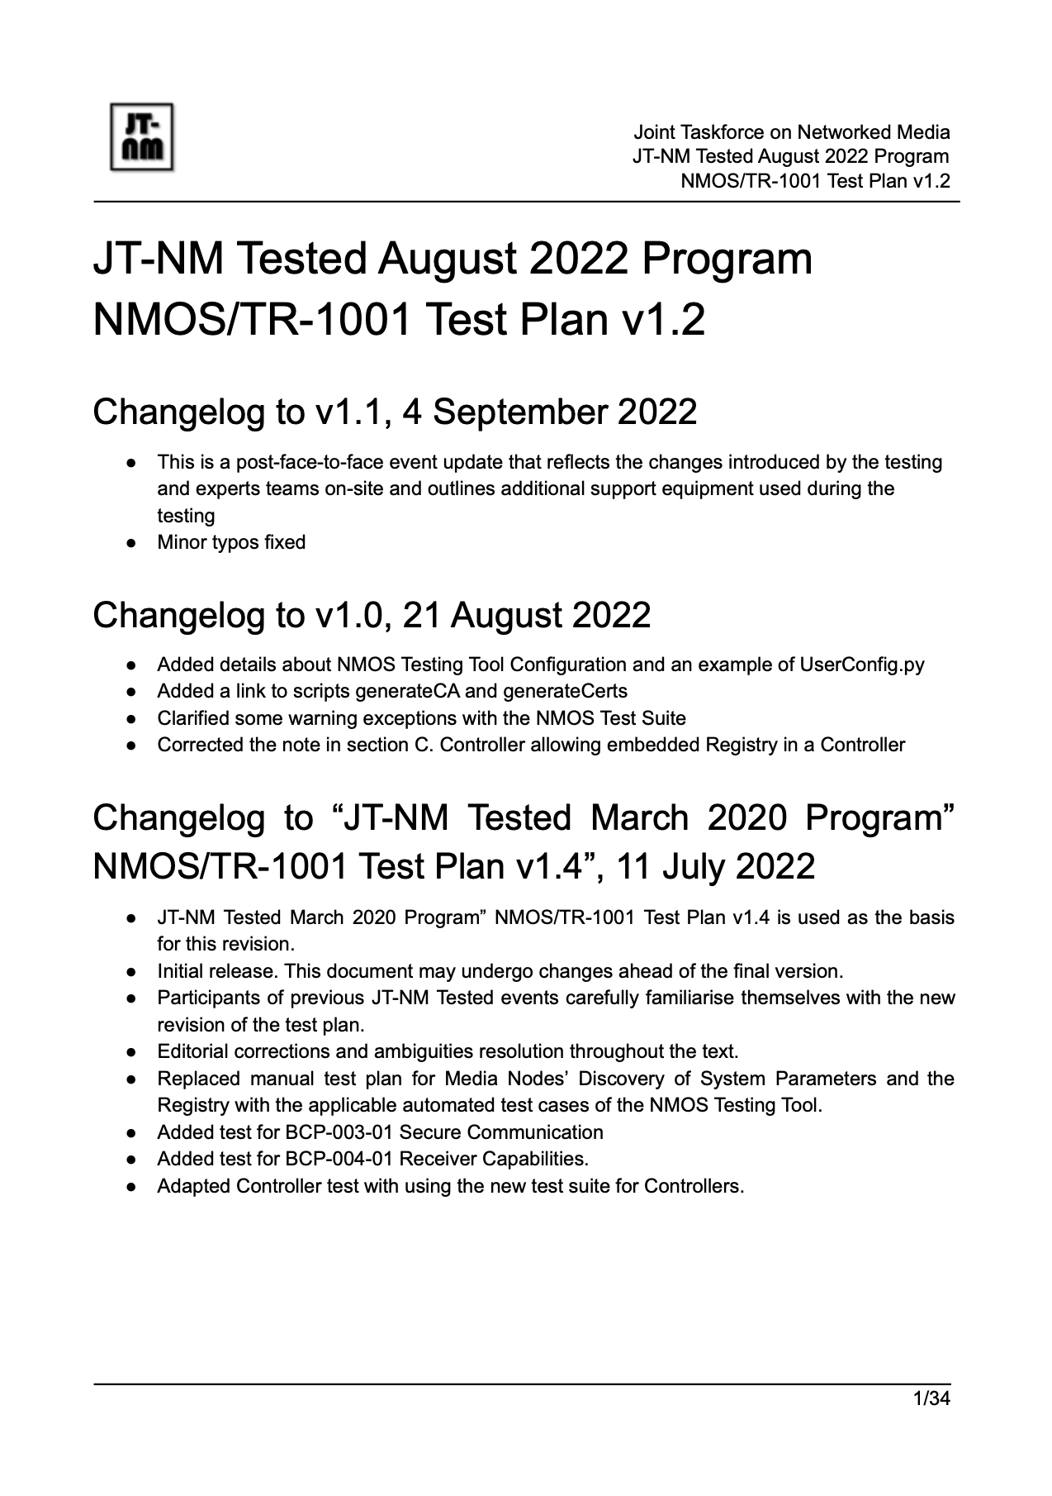
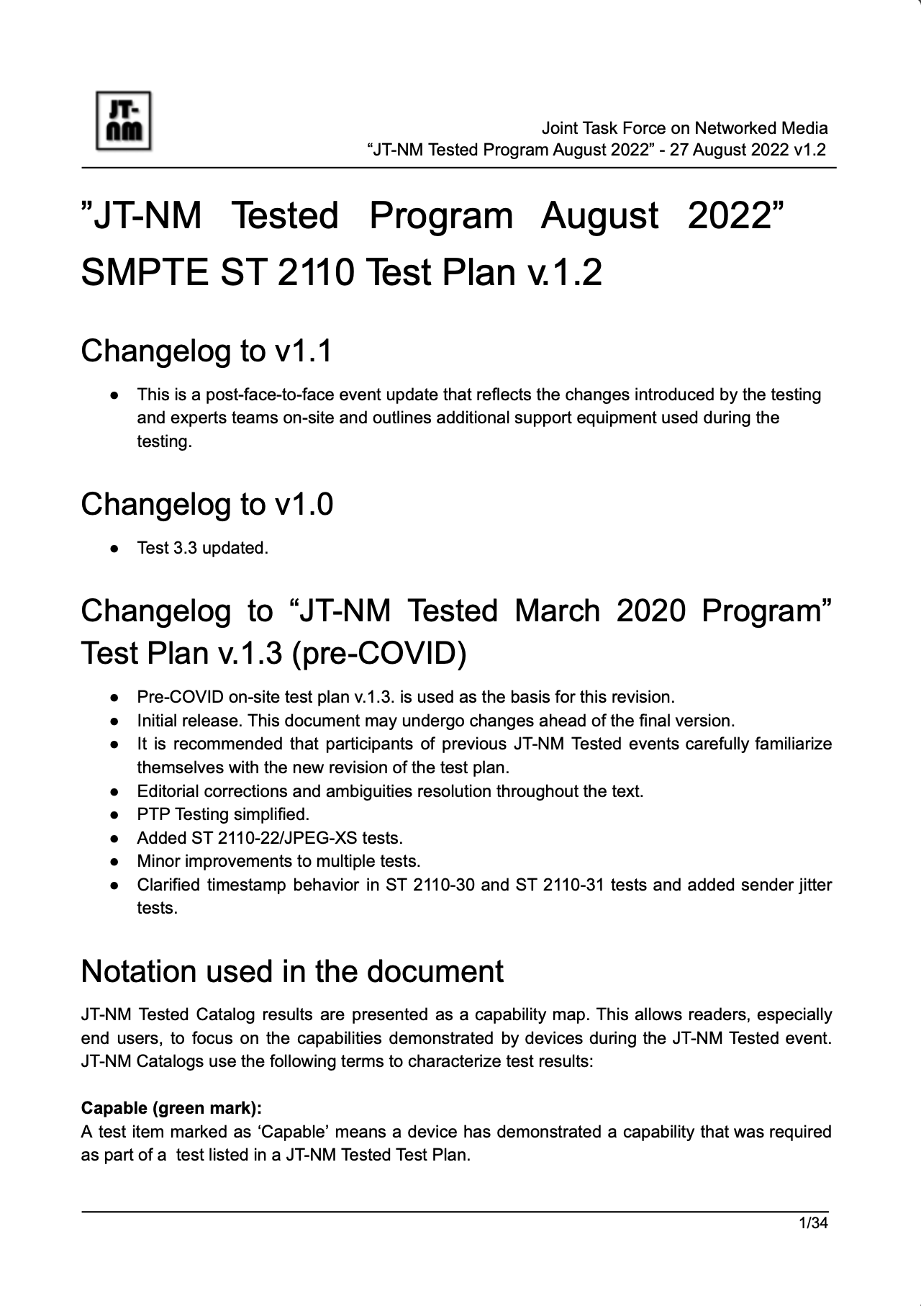
JT-NM Tested Program – Test Plans & Tools
Test Plans:
SMPTE ST 2110 Test plan
NMOS/TR-1001-1 Test plan
Cybersecurity Test Plan
Main testing tools:
EBU LIST + multiple T&M devices
AMWA NMOS Testing Tool

Slide 6
SMPTE ST 2110 Test Plan
NMOS / TR-1001 Test Plan
Cybersecurity Testing

Slide 7
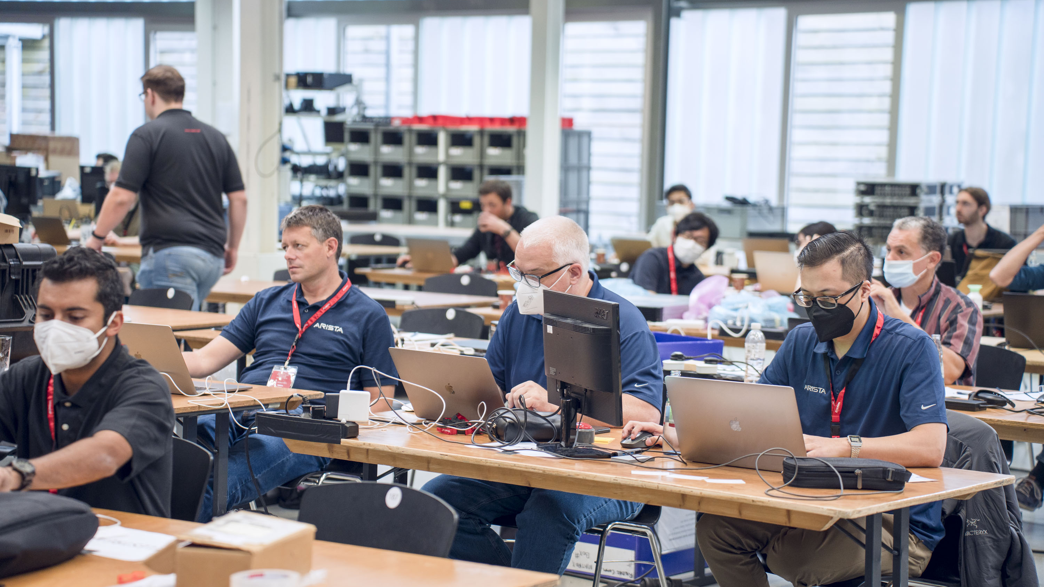
NETWORK AND INFRASTRUCTURE

Slide 8
JT-NM Tested Program – Network and infrastructure
Objectives:
Provide a “real-world” scenario
Highlight ST 2110 network design best practice
Resilience and Reliability through design
Solution:
Spine-leaf topology, Amber and Blue media networks
Routed access
BGP Dynamic routing
Full multicast routing (IGMP / PIM)
Multiple management VLANs for general use and NMOS testing
Dual resilient PTP GMs
Routable OOB network for switch management

Slide 9
JT-NM Tested Program – Network and infrastructure
16 switches in total:
2x spine
10x leaf
4x OOB management
PTP:
2x grandmasters by Telestream
DHCP:
577x scopes
Over 5000x lines in the config file
DNS:
DNS-SD for NMOS registry discovery
NMOS registry:
Easy-NMOS by Richard Hastie
Number of ports:
48x 100G
8x 40G
116x 25G
75x 10G
215x 1G (Both media and management)
A strong move from 10G to 25G, and from 40G to 100G.

Slide 10
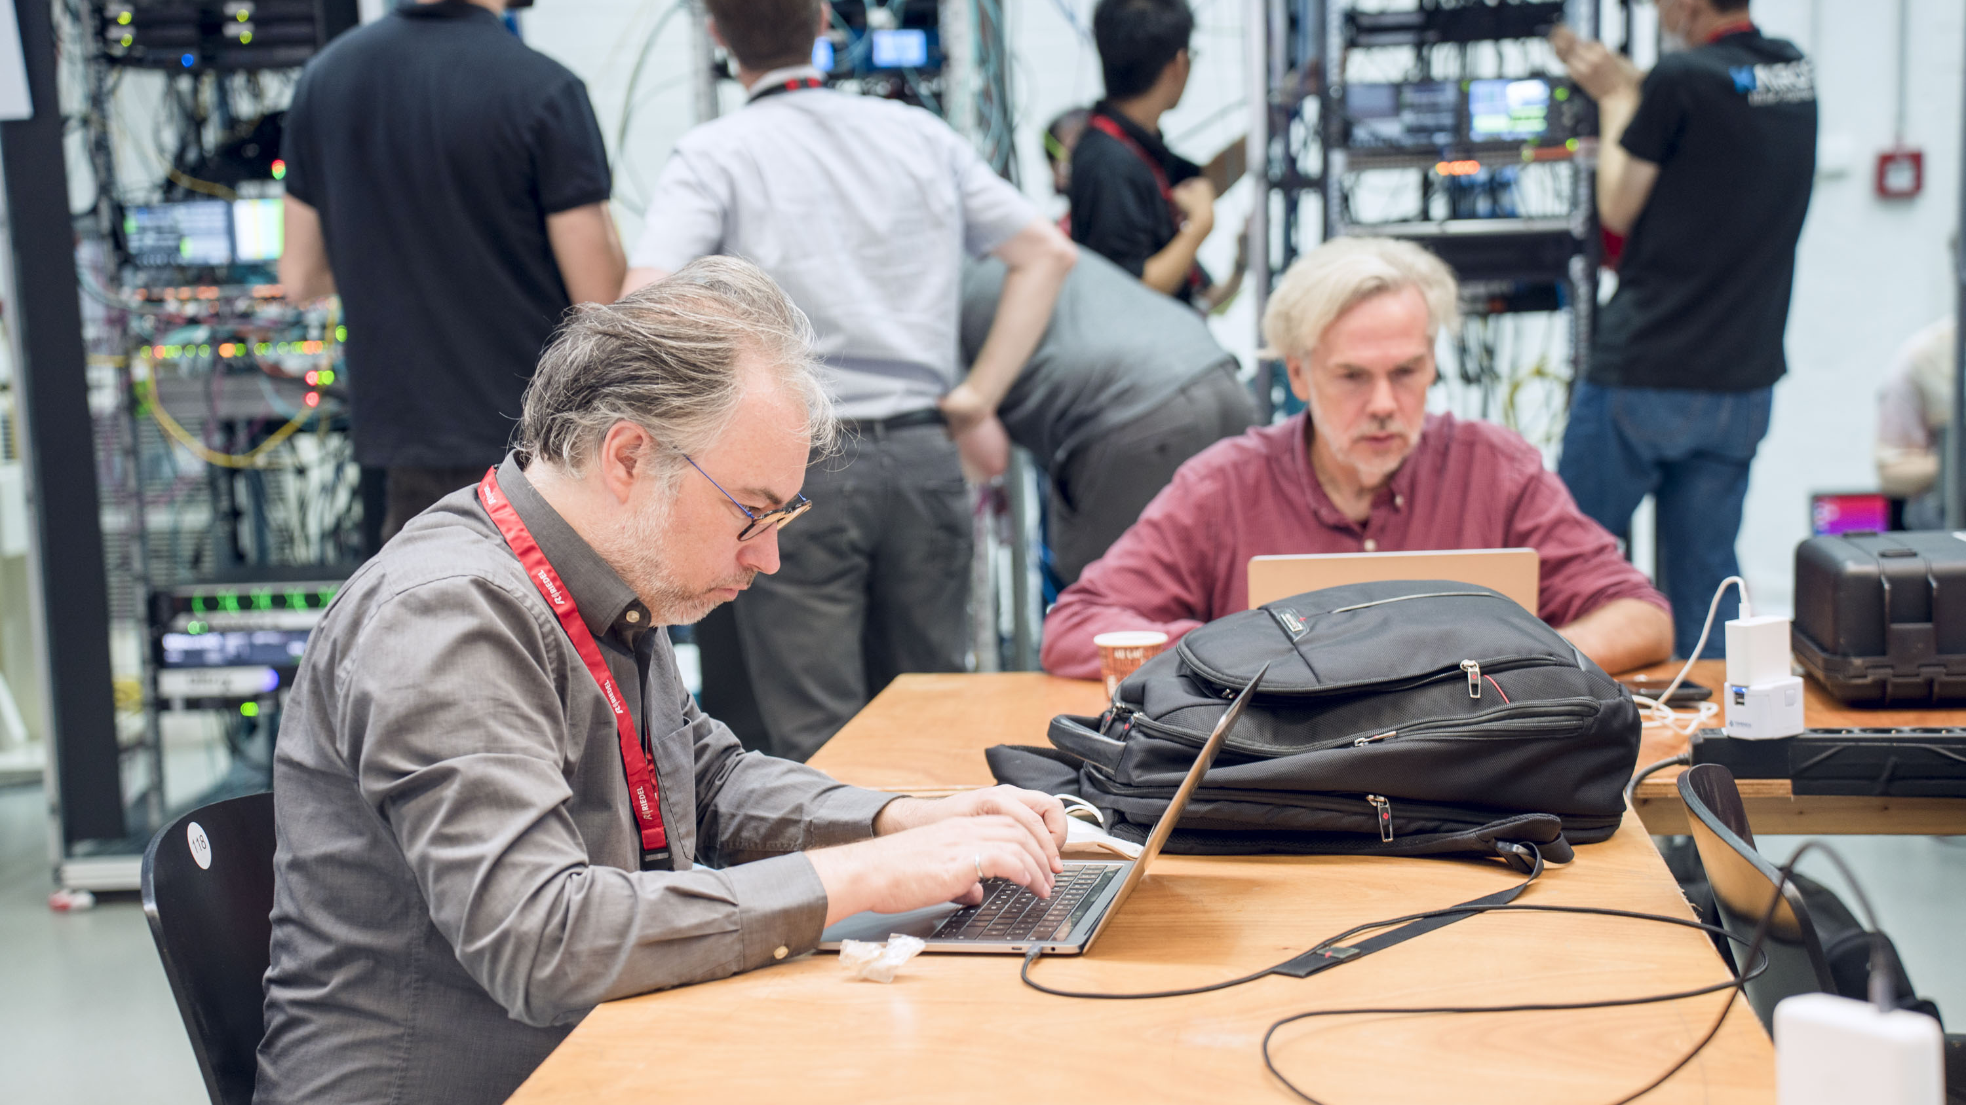
FINDINGS AND RESULTS
https://jt-nm.org/jt-nm_tested/

Slide 11
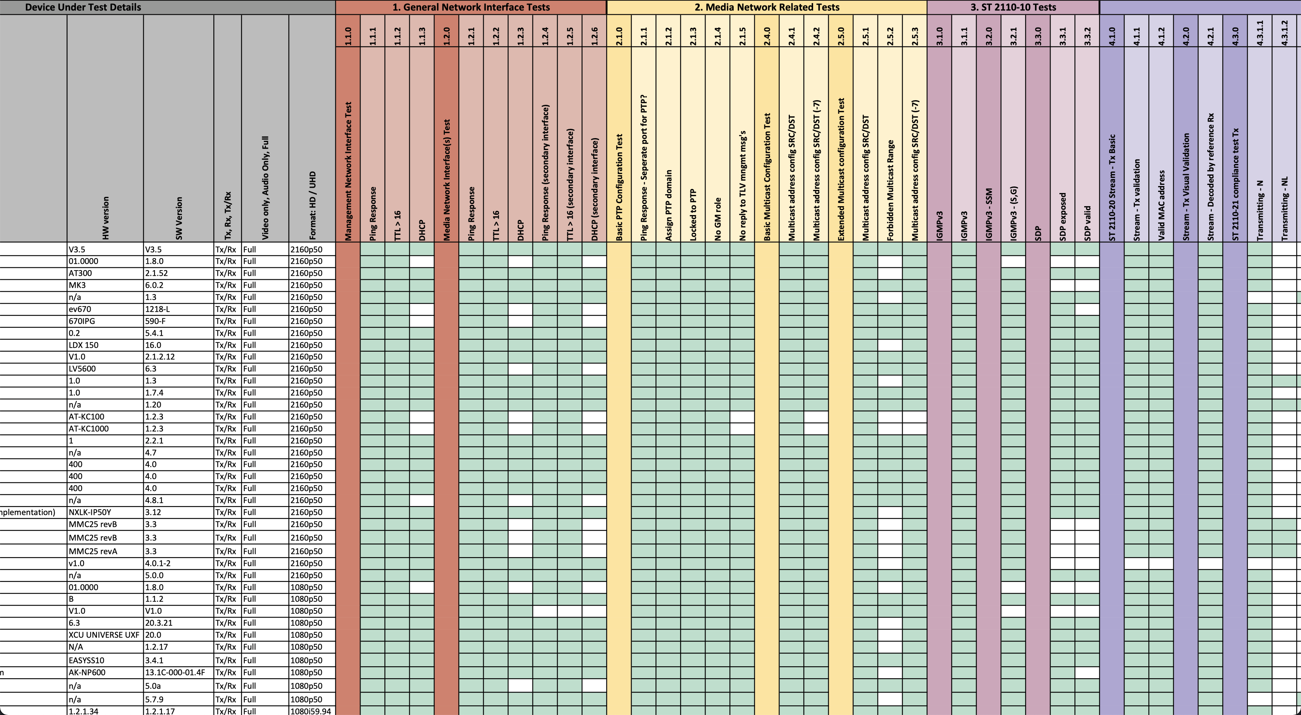
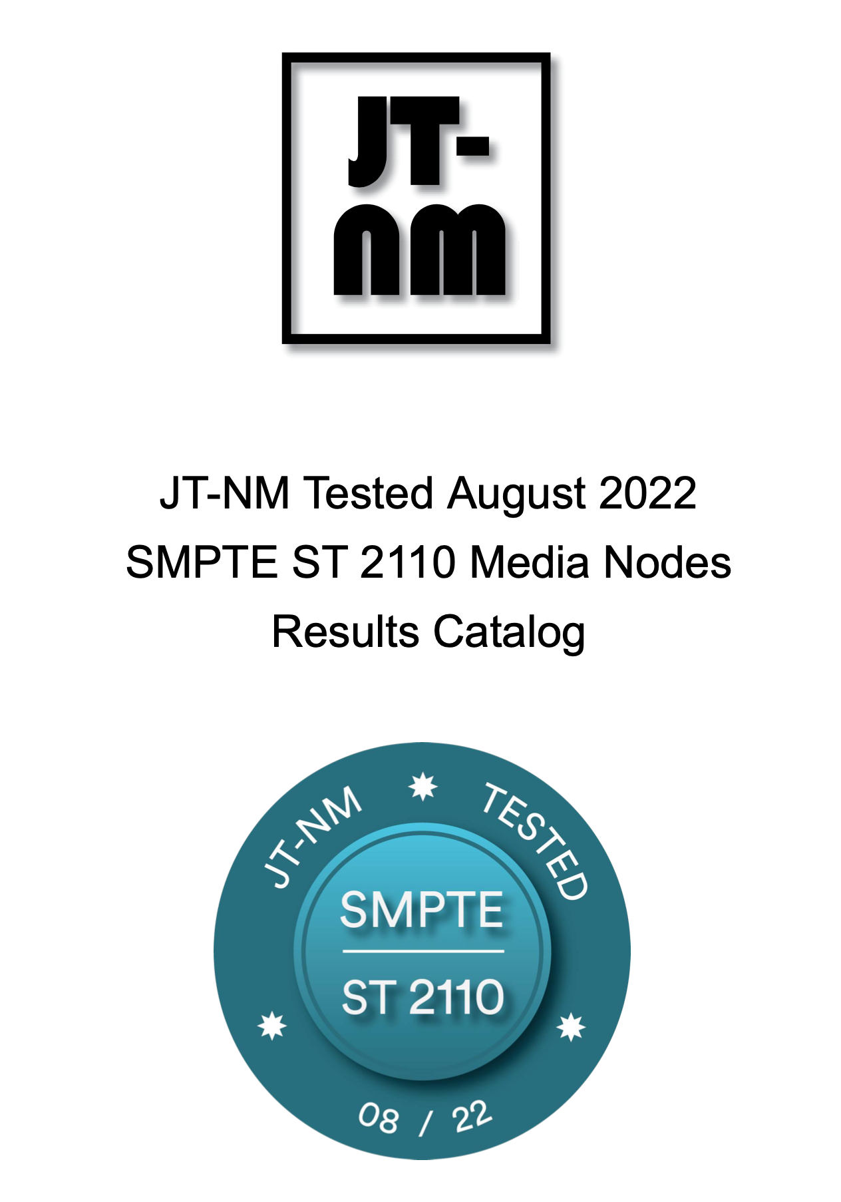
Results of ST 2110 Testing (content by Willem Vermost, VRT)
Data plane: Basic SMPTE 2110 behavior

Slide 12
SMPTE ST 2110 Test Plan (content by Willem Vermost, VRT)
Network Tests
SMPTE ST 2110-20
Download results and test plan!
SMPTE ST 2110-22
SMPTE ST 2110-30
SMPTE ST 2110-31
SMPTE ST 2110-40
SMPTE ST 2022-7

Slide 13
Results – SMPTE ST 2110 Test Plan (content by Willem Vermost, VRT)
35 vendors published their results in the final catalog.
+1 compared to the previous event
A few newcomers were welcomed
84 products were tested against the ST 2110 test plan (142% compared to previous catalog)
63 Video devices
44 devices were presented as a UHD capable
39 Tx/Rx devices
13 Rx devices
11 Tx devices
17 Audio only devices
13 Tx/Rx devices
11K tests executed in total!

Slide 14
Results – SMPTE ST 2110 Test Plan (content by Willem Vermost, VRT)
Network Interface Tests
67% use DHCP on management network interface
61% use DHCP on Media network interface
99% respect the GM role when in “slave only”
96% properly react to PTP TLVs
57% warn or prohibit the use of the restricted multicast range (224.0.0.0-224.0.1.255)
ST 2110-10
100% support and use IGMPv3 (*,G)
67% support IGMPv3 SSM (S,G)

Slide 15
Lessons Learned – ST 2110 (content by Willem Vermost, VRT)
ST 2110-10
67% expose and SDP
93% of exposed SDPs were valid
ST 2110-20
94% produce a valid stream
94% produce a stream within the profile limits of N, NL or W
86% Produce a stream within the boundaries of the VRX limits.
92% can receive Wide streams
ST 2110-22
25% of the devices demonstrated the ST 2110-22 capabilities

Slide 16
Lessons Learned – ST 2110 (content by Willem Vermost, VRT)
ST 2110-30
96% of the devices demonstrated capabilities for the ST 2110-30 tests
77% have recommended DSCP values according to AES67
ST 2110-31
39% of the devices demonstrated capabilities for the ST 2110-31 tests
ST 2110-40
82% of the devices demonstrated capabilities for the 2110-40 tests
ST 2022-7
88% of the devices demonstrated capabilities for 2022-7 tests
58% had valid Seamless Protection Switching, critical for designing a resilient facility!

Slide 17
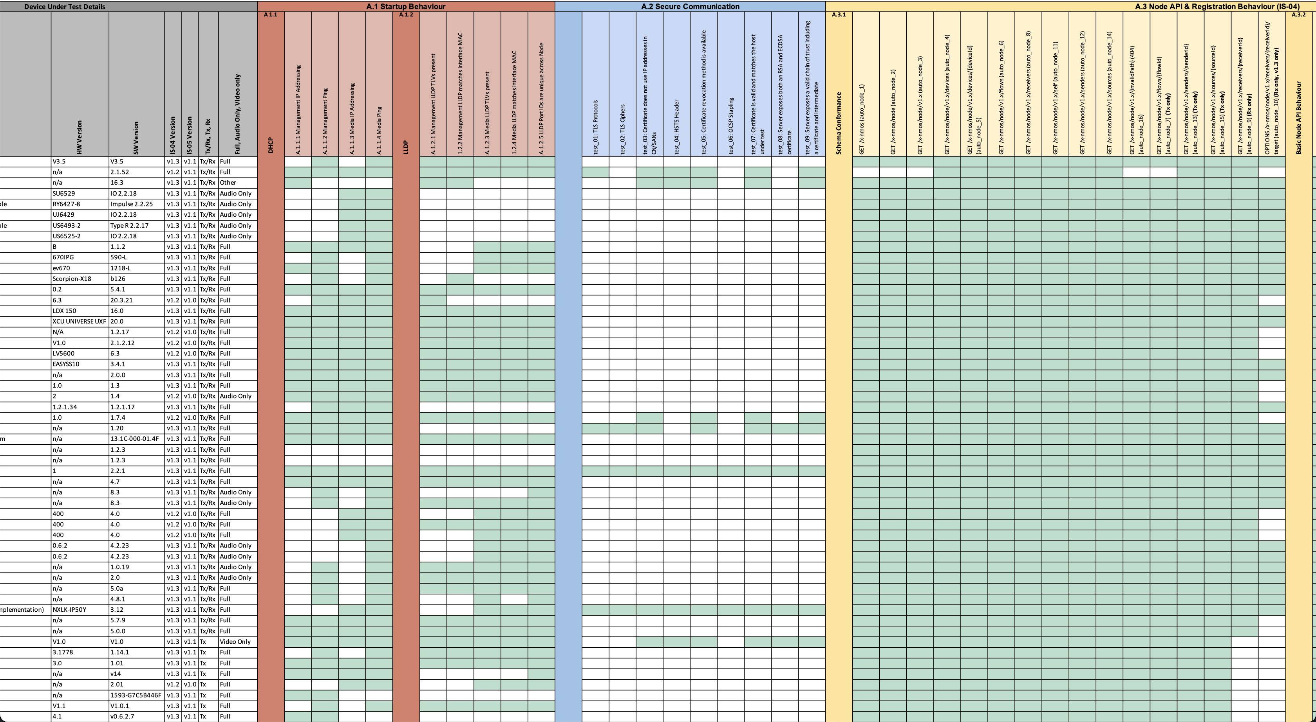
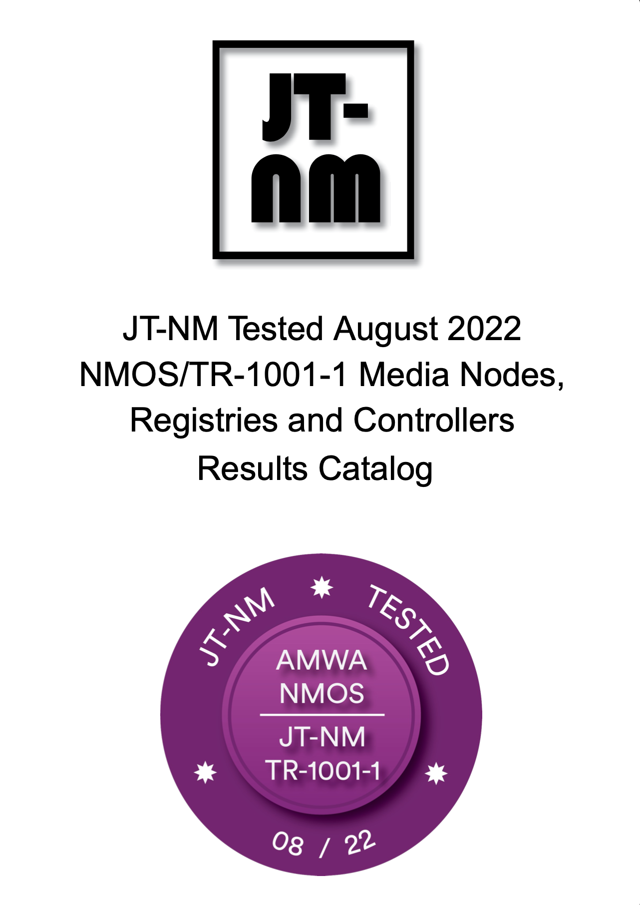
Results of NMOS/TR-1001-1 testing (content by Felix Poulin, CBC/Radio Canada)
Control plane: NMOS/TR-1001-1 behavior

Slide 18
NMOS/TR-1001-1 Test Plan (content by Felix Poulin, CBC/Radio Canada)
Startup Behaviour
Secure Communication (BCP-003-01)
Download results and test plan!
Node API & Registration Behavior (IS-04)
Connection Management (IS-05)
Audio Channel Mapping (IS-08)
System Parameters (IS-09)
Receiver Capabilities
(BCP-004-01)
NMOS Registry Tests

Slide 19
Results – NMOS / TR-1001-1 Test Plan (content by Felix Poulin, CBC/Radio Canada)
17K tests executed - 92% automated!
Nodes
74 Media Nodes +118% from 2020
from 35 vendors + 75% from 2020
87% of ST 2110 Devices tested for NMOS
Growing adoption!
Capabilities
90% tests passed IS-04 Reg. and Discovery
65% do Natural Grouping (BCP-002-01)
8% do Receiver Capabilities (BCP-004-01)
91% tests passed IS-05 Connection Management
Maturity of most of IS-04 and IS-05 implementations!

Slide 20
Results – NMOS / TR-1001-1 Test Plan (content by Felix Poulin, CBC/Radio Canada)
12% do basic or full Secure Communication (BCP-003-01)
A beginning, but long way to go!
59% do System Parameters (IS-09)
19% do Audio Channel Mapping (IS-08)
76% do LLDP
Controllers and Registries
9 Controllers and Registries +29% from 2020
Capabilities
94% of Controller tests passed
66% of Registries partially supporting secured communication (BCP-003-01)
79% Registry tests passed (IS-04)

Slide 21
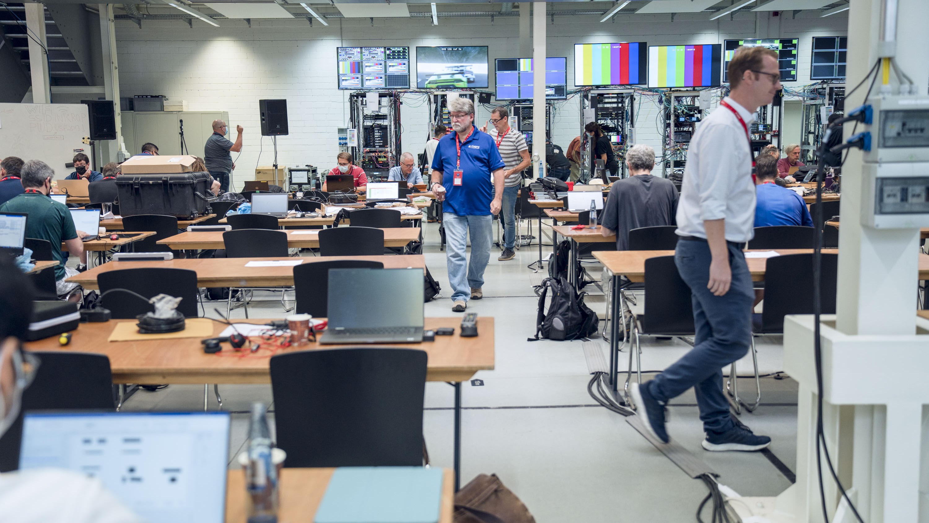
CYBERSECURITY ASSESSMENT FINDINGS AND RESULTS
http://jt-nm.org/jt-nm_tested/

Slide 22
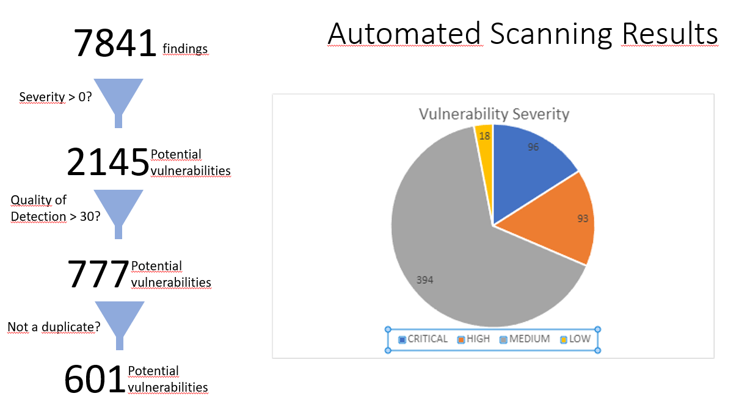
Cyber Security – Early results straight from the oven of Gerben Dierick, VRT

Slide 23
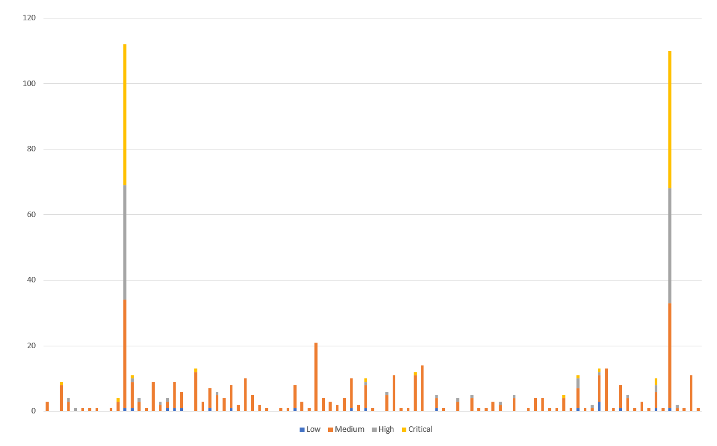
Cyber Security – Early results straight from the oven of Gerben Dierick, VRT

Slide 24
EARLY CONCLUSIONS AND OUTCOMES
http://jt-nm.org/jt-nm_tested/

Slide 25
Early conclusion and outcomes
It’s time for the EBU Pyramid revision.
JT-NM will look for a way to make the testing more automated and sustainable.
Extensive NMOS support is essential for future automatable testing. The value of the Badge must be revised and increased
The industry needs networking and PTP interop.
The cybersecurity situation hasn’t improved a lot – needs additional attention.
Another round of testing may take place in the Summer of 2023, with preparatory exercises to start soon.

Slide 26
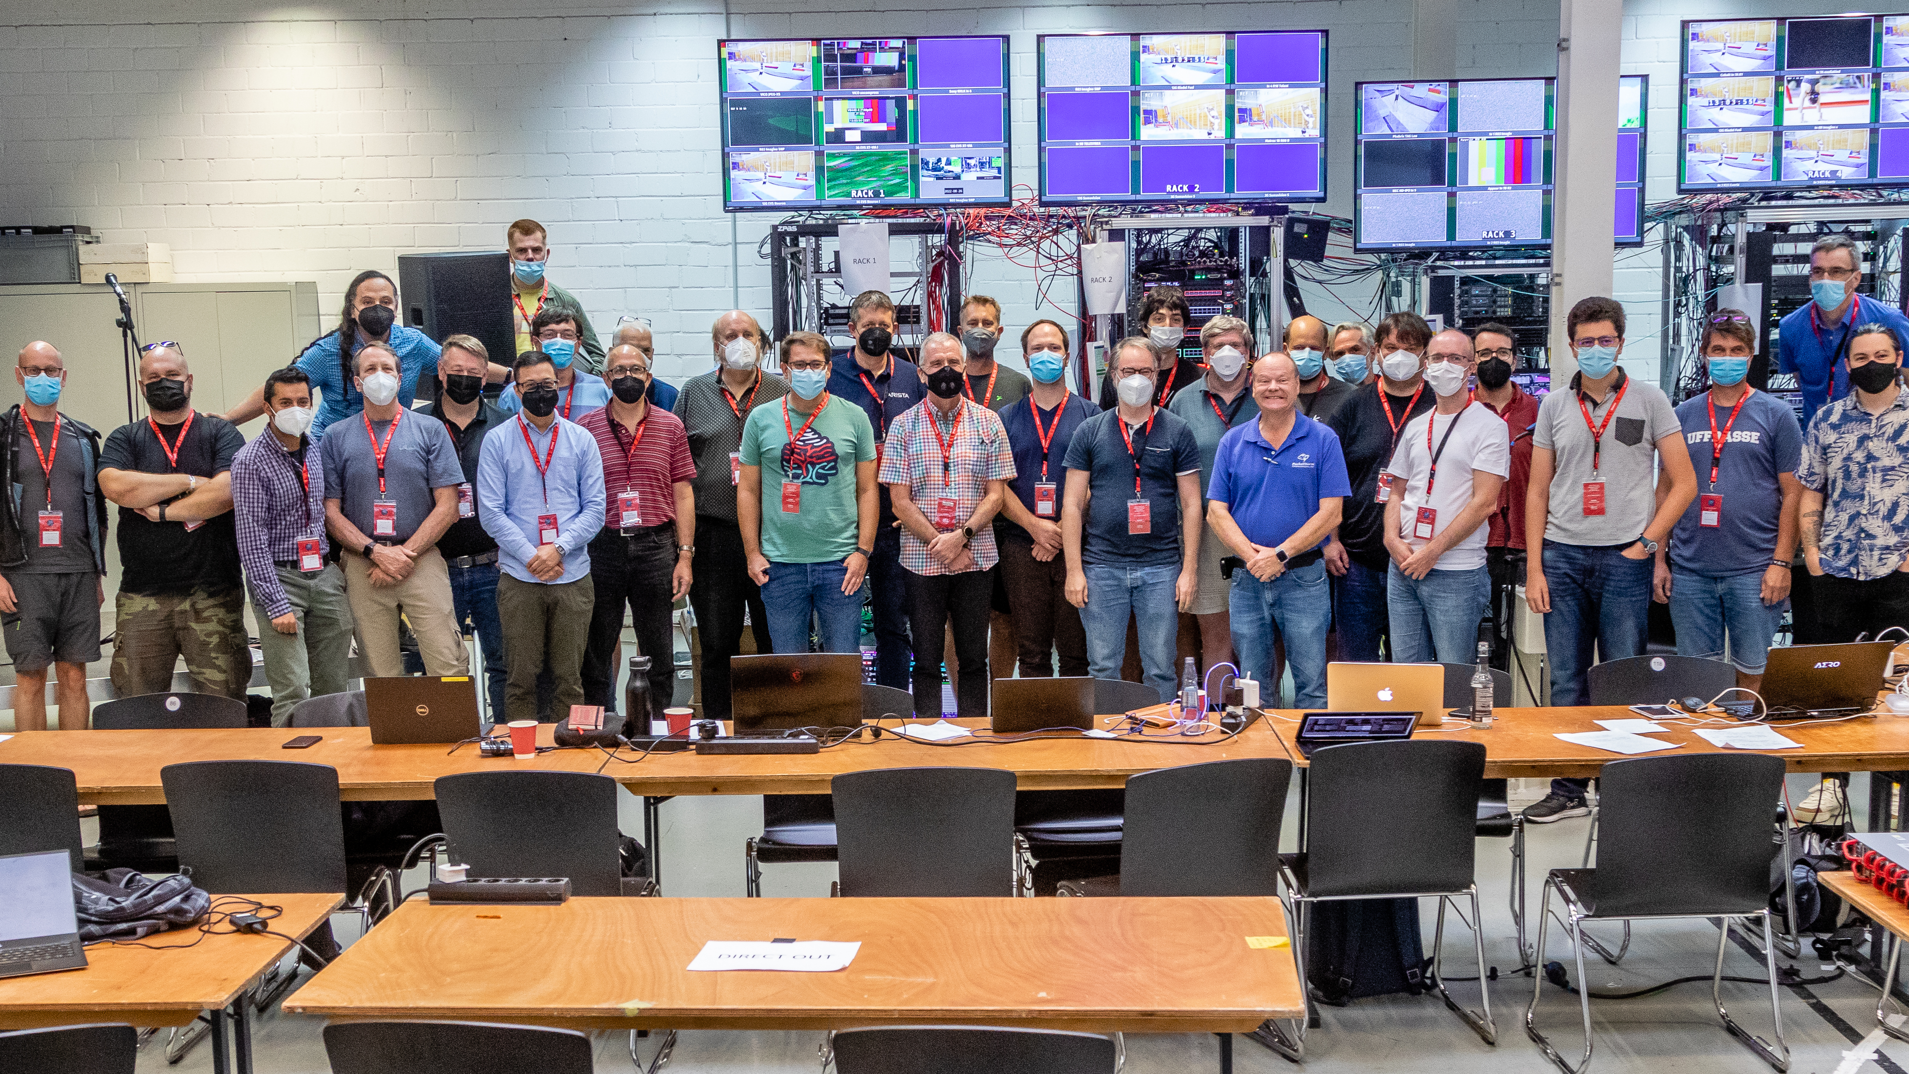
Thank you from the JT-NM Tested Team
https://jt-nm.org/jt-nm_tested/

