Slide 1
The road to full IP - An IT perspective
Dr. Gabriel Kerner, Alvalinks

Slide 2
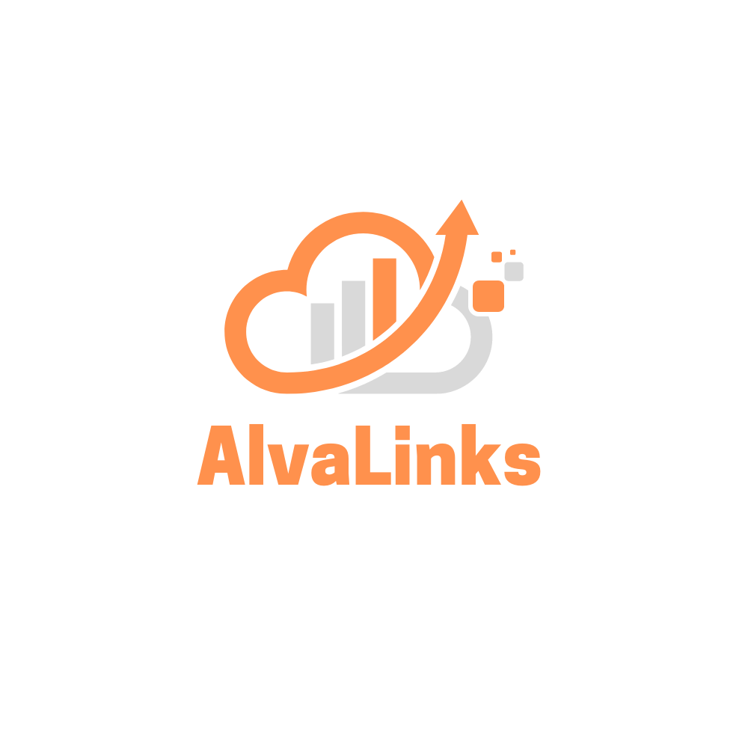
Alvalinks - intro
AI system to abstract, manage, automate and assure live video delivery over internet and cloud
Broadcast and Networking experts
VSF member and RIST contributors

Slide 3
Digital Transformation
Make business relevant in a digital era,
while growing opportunities and profits,
as well as scaling efficiently in the process.

Slide 4
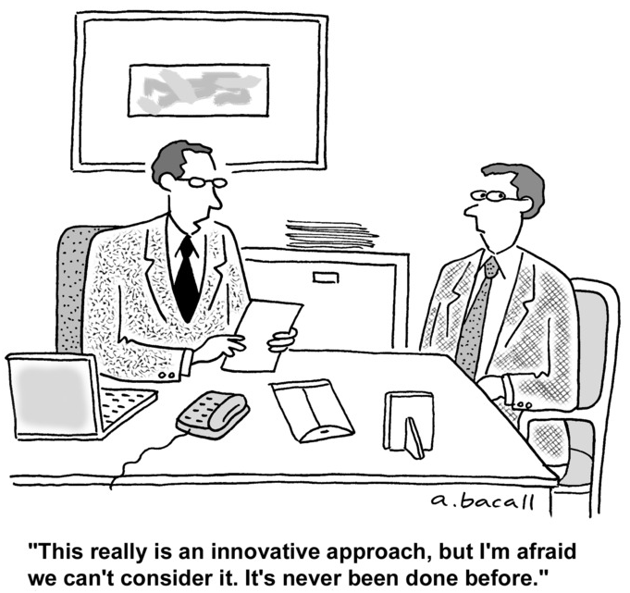
Adapt disruptive technologies
What would my digital customer do?
New understanding that consumer habits and expectations are outpacing organizational infrastructures
Update legacy technologies and methodologies to better reflect how the real world is evolving

Slide 5
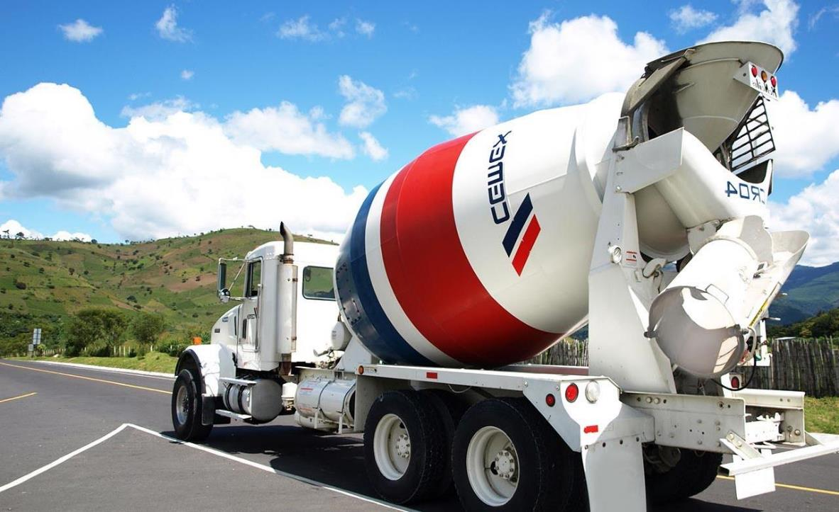
From 3 hours to 20 mins The story of CEMEX

Slide 6
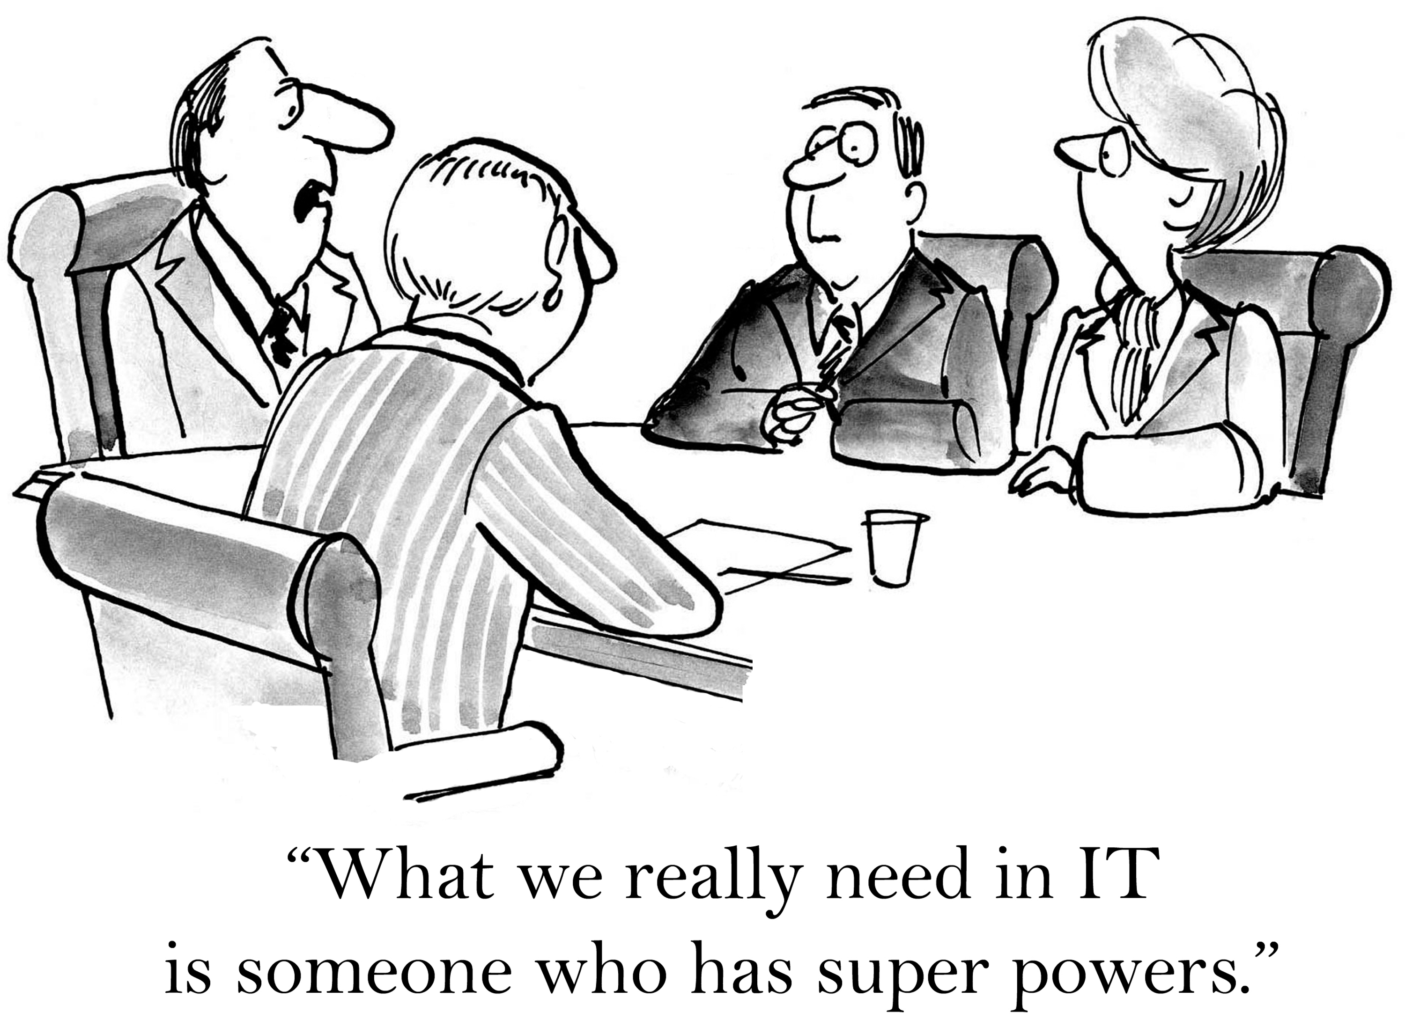
SD-WAN – unleash the power
Path Control and Path Selection
Zero-touch provisioning
Intuitive administration workflows
integrate routing with value-adding services (security, cloud,…)

Slide 7
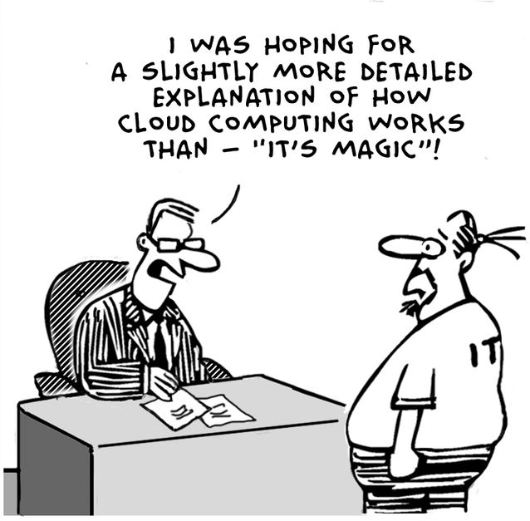
Public Cloud – it’s magic
Ultimate scalability
Cost effective
Reliability
Flexibility
Universally accessible

Slide 8
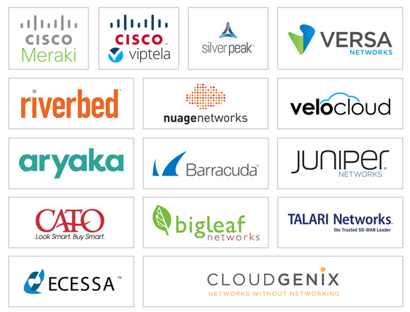
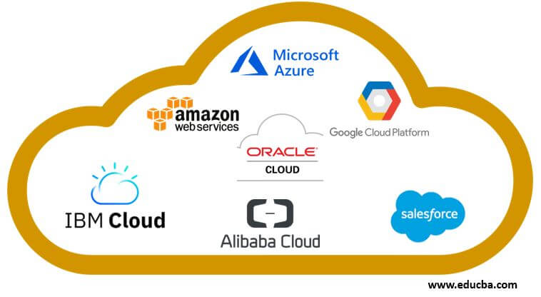
A full ecosystem

Slide 9
Magic?

Slide 10
“En route” to digital transformation: facing multidimensional challenges
Control & visibility
Connecting multiple environments
How to manage the big picture?
Security across all apps, devices, and networks
Workloads chained across multiple sites
services deployment complexity

Slide 11
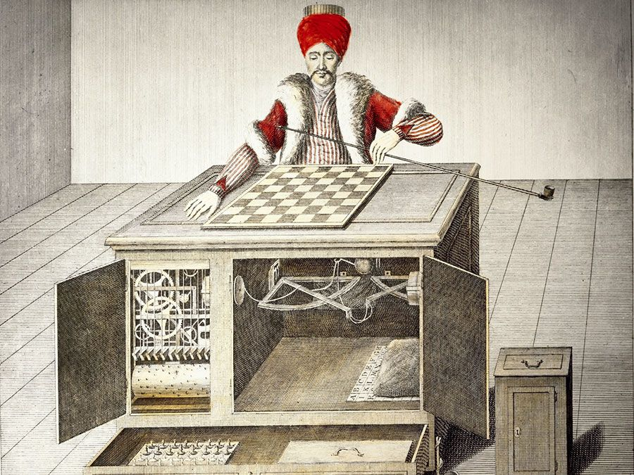
Automation has never been a simple task
Networking complexities
Dev-ops and other specialized skills
Exponential configurations options
No support
Unpredictable costs
challenging control & manageability
The mechanical turk

Slide 12
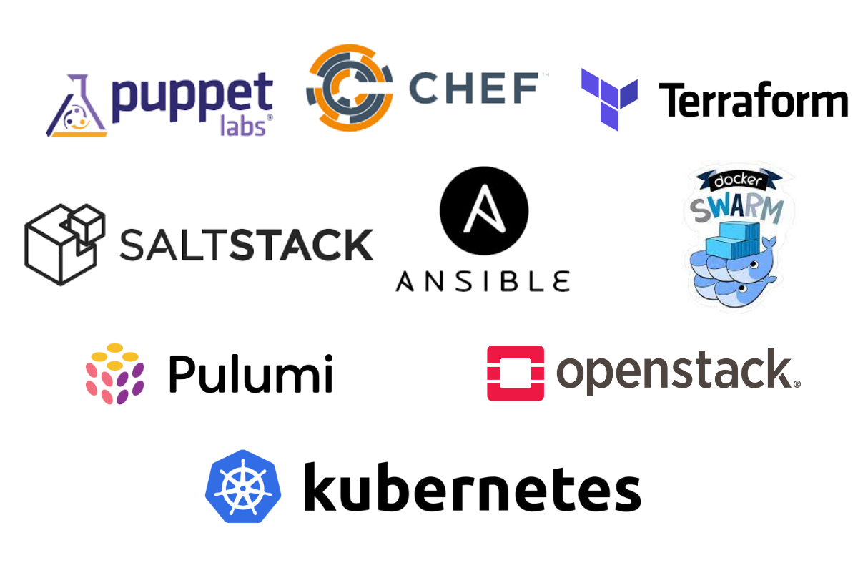
Ecosystem of orchestration

Slide 13
The future is Live video
Audience 20X more engaged
with live video content
Notes:
UNLIKE broadcast… the future….
It means 100s of thousands of new live video content creators will appear
Mass utilization of internet & cloud
UDP & New standards
Automation & simplification
Bandwidth everywhere
Everybody can source & create
distribution platforms
Increase engagement
Better monetize

Slide 14
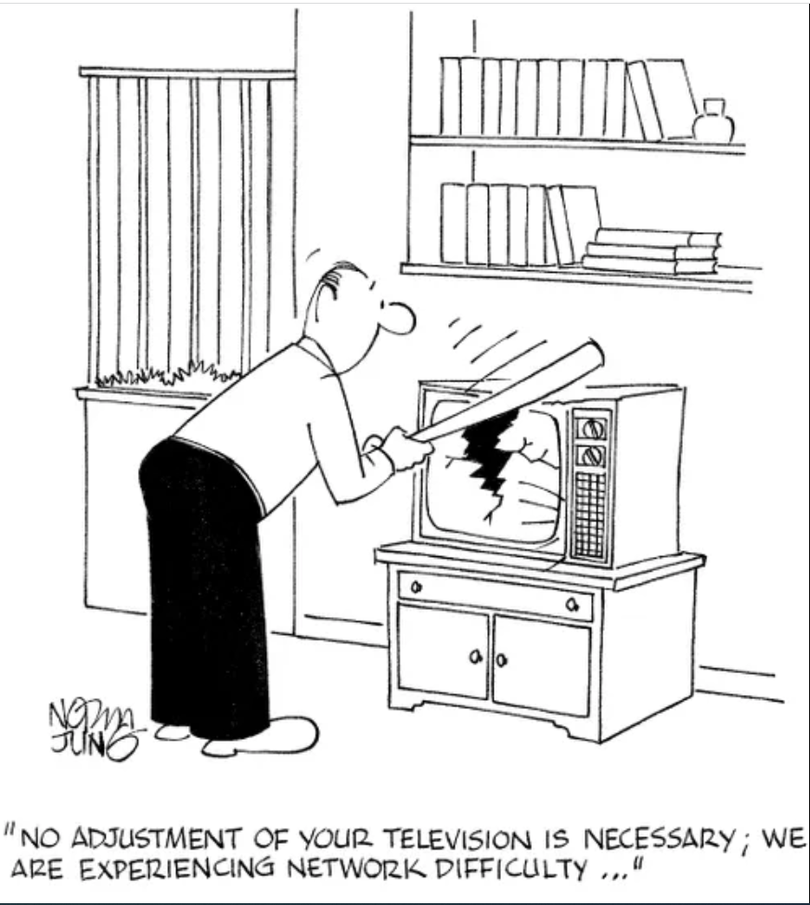
Broadcast challenges
Security,
Deployment
Integration
Automation & orchestration
Transport & delivery
Latency – challenging!
Live high bitrate – challenging!

Slide 15
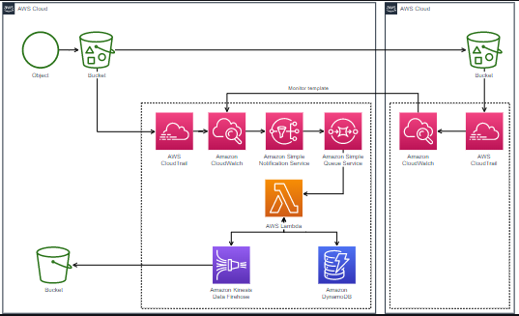
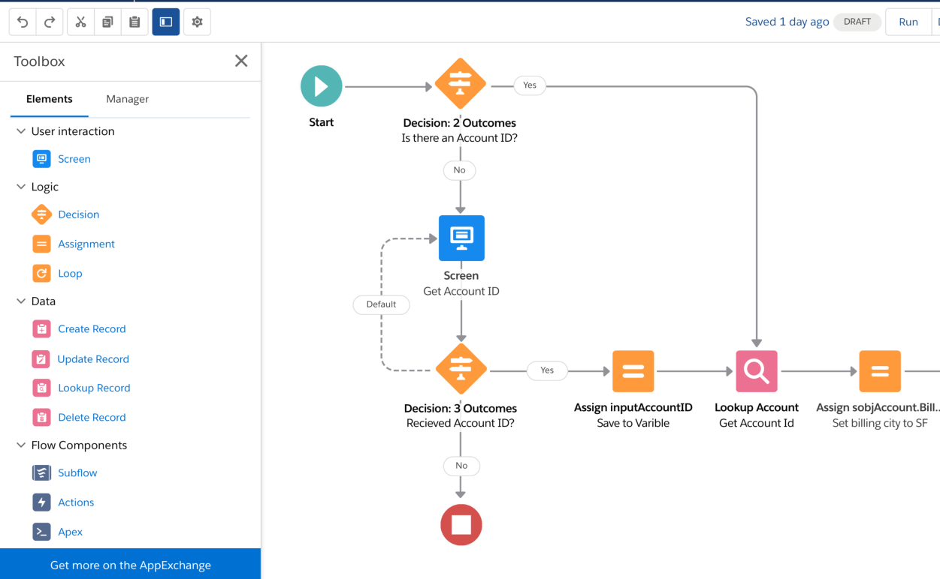
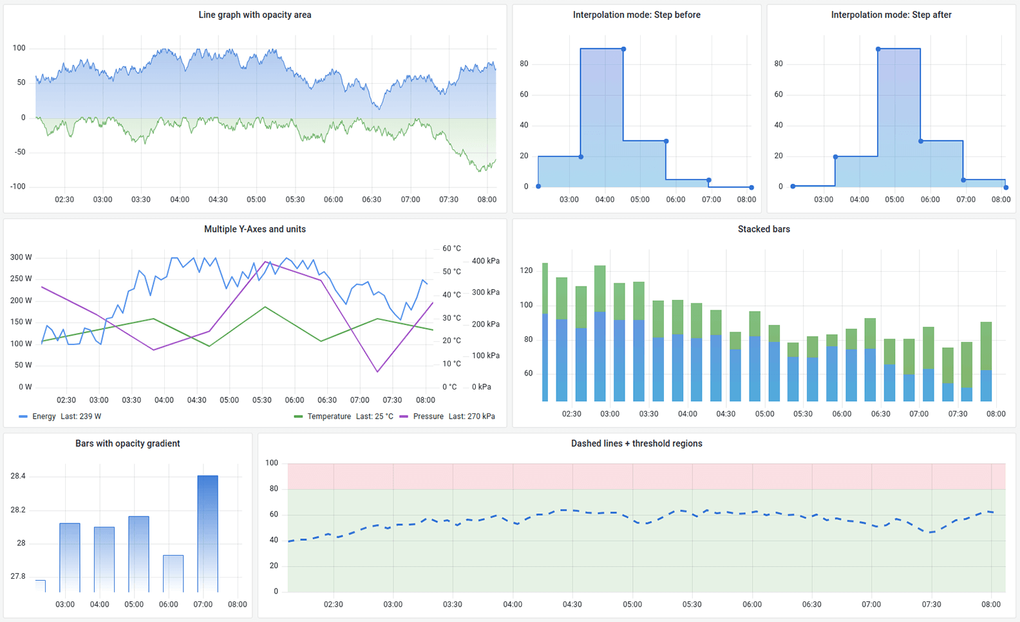
Job to be Done
AI system to abstract, manage, automate and assure
live video delivery over internet and cloud

Slide 16
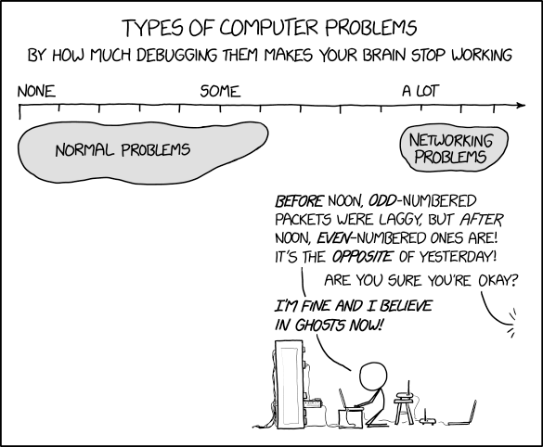

Slide 17
