Slide 1
Timestamps in ST 2110 and what they mean and how to measure them
Kieran Kunhya – kierank@obe.tv

Slide 2
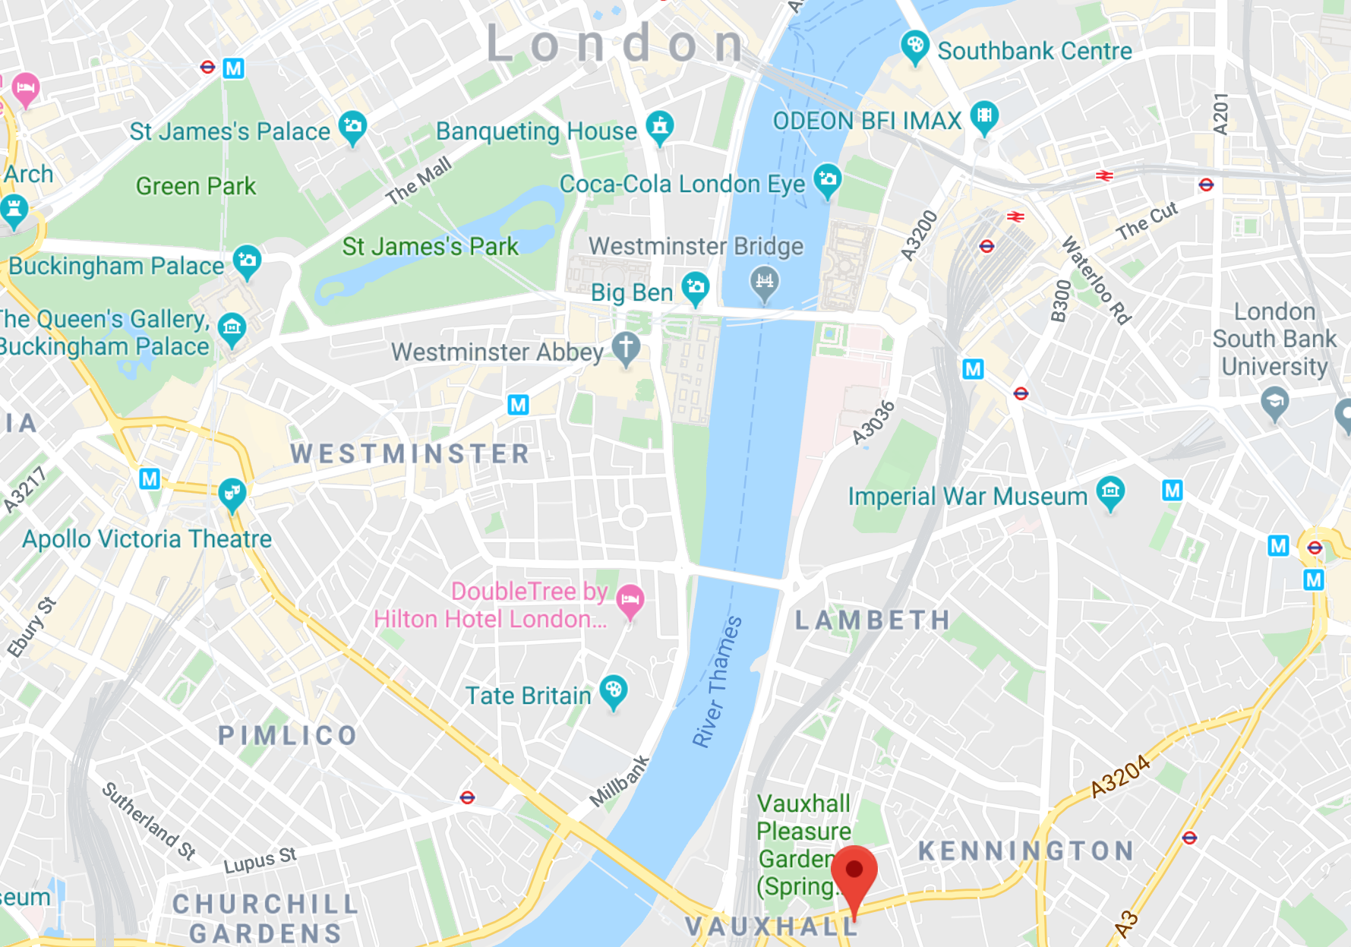
Company Introduction
Company specialising in software-based encoders and decoders for Sport, News and Channel contribution (B2B)
Based in Central London
Build everything in house
Hardware, firmware, software
Not to be confused with:

Slide 3
Presentation difficulty level
Easy: “How to Explain ST 2110 to a six-year-old” – me, NAB 2022
…
…
…
Medium: This presentation
…
…
Difficult: PTP presentations (Kernen et al), ST 2110-21/EBU LIST (Vermost et al)
Notes:
Some level of introductory work, then some level of basic mathematical analysis

Slide 4
What am I going to talk about?
Why do we need timestamps?
PTP (very very abridged)
RTP timestamp calculation
Timestamps vs packet arrival times
Measurements
How a receiver should use timestamps
Where/Why things go wrong

Slide 5
Why do we need timestamps?
In 2110 video and audio are sent as different flows
Receivers subscribe to the flows they need to. Audio receiver doesn’t need to receive high bandwidth video
Raw video and audio sent on network – From various sources and points in time
In order to synchronise, timestamps are used by the receiver to match audio and video
Correspond to a given instant of capture
All packets of a video frame/field have same timestamp

Slide 6
PTP (very very abridged)
Split the audio and video up into thousands of little packets
Imagine all television signals start at the same time,
Each video frame/field last a number of clock ticks
Calculate how many pictures there would have been by now and on which clock tick the next picture will begin
1st January 1970
(PTP epoch)
52 years later…
Now
PTP Alignment Point

Slide 7
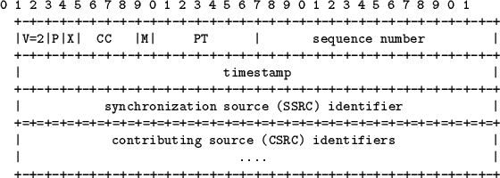
RTP timestamp calculation
Timestamp is in the RTP header of each packet using PTP clock
32-bit value, 90kHz clock for video, 48kHz for audio
Video timestamp wraps round after ~13 hours, audio timestamp wraps after ~25 hours.
59.94 frame/field rates not divisible by 90kHz
Worked Example: Midnight (TAI) 1st June, 2022 at 1080i25:
One Frame or Field
T = 19144 [days] * 86400 [seconds in a day] * 90000 [clock]
floor( T / 25 [frames per second] ) * 25 [frames per second]
148863744000000 (PTP timestamp 90kHz)
148863744000000 mod 2^32 =
177520640 = RTP Timestamp = PTP alignment time
Alignment point 1
Alignment point 2
Notes:
Substantially more care needed with fractional framerates. Also when implementing this in software, can have integer overflows if not careful. Headache inducing

Slide 8
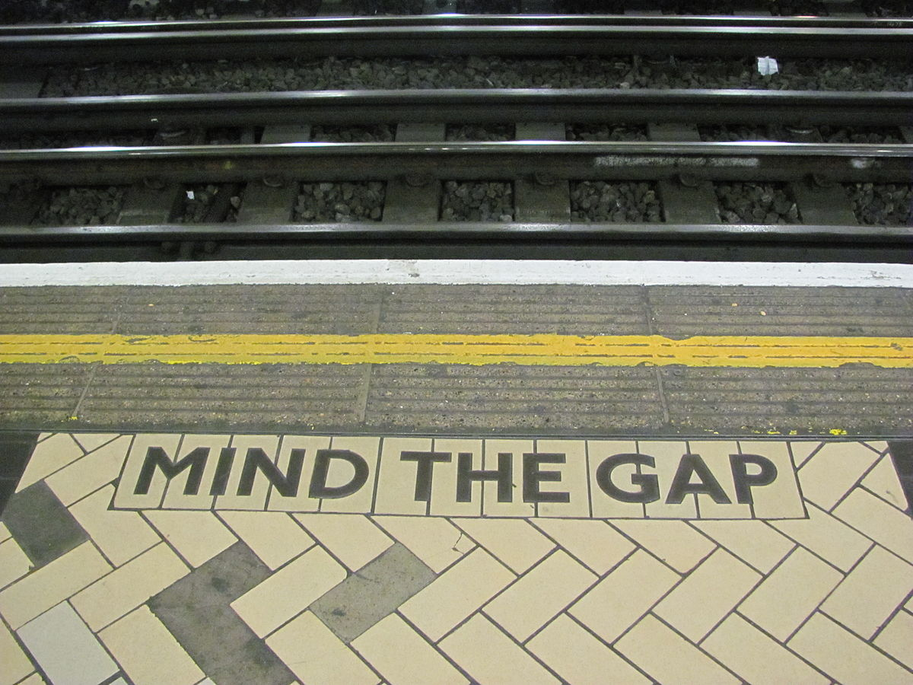
Timestamps vs packet arrival times
But the timestamp in the header isn’t the same as the packet arrival time
Most facilities use gapped mode to account for historical blanking data and first packet arrives ~700us after beginning of the frame (PTP alignment point)
Some scopes don’t make it obvious what time they are referring to. Sometimes hidden in a different menu
Will talk later how this can go wrong
Understand what you are measuring!

Slide 9
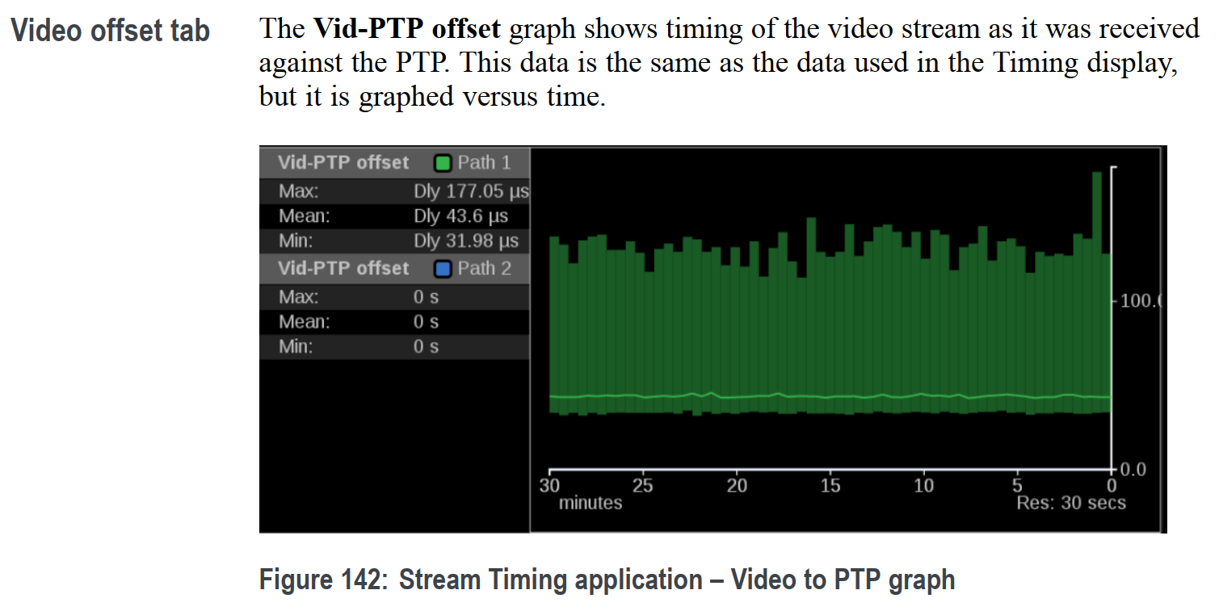
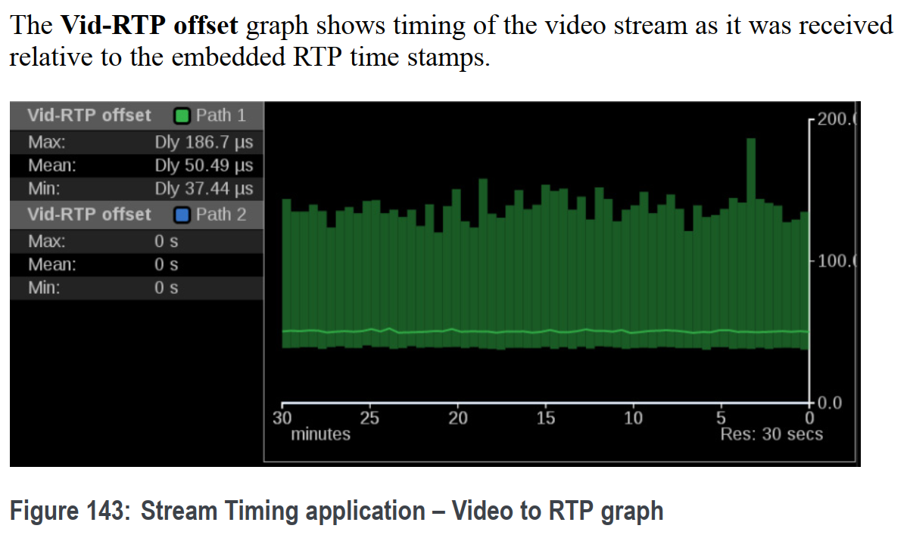
Timestamps vs packet arrival times
Left: Packet arrival time relative to PTP alignment point
Right: RTP timestamp relative to PTP alignment point
Either could be wrong!

Slide 10
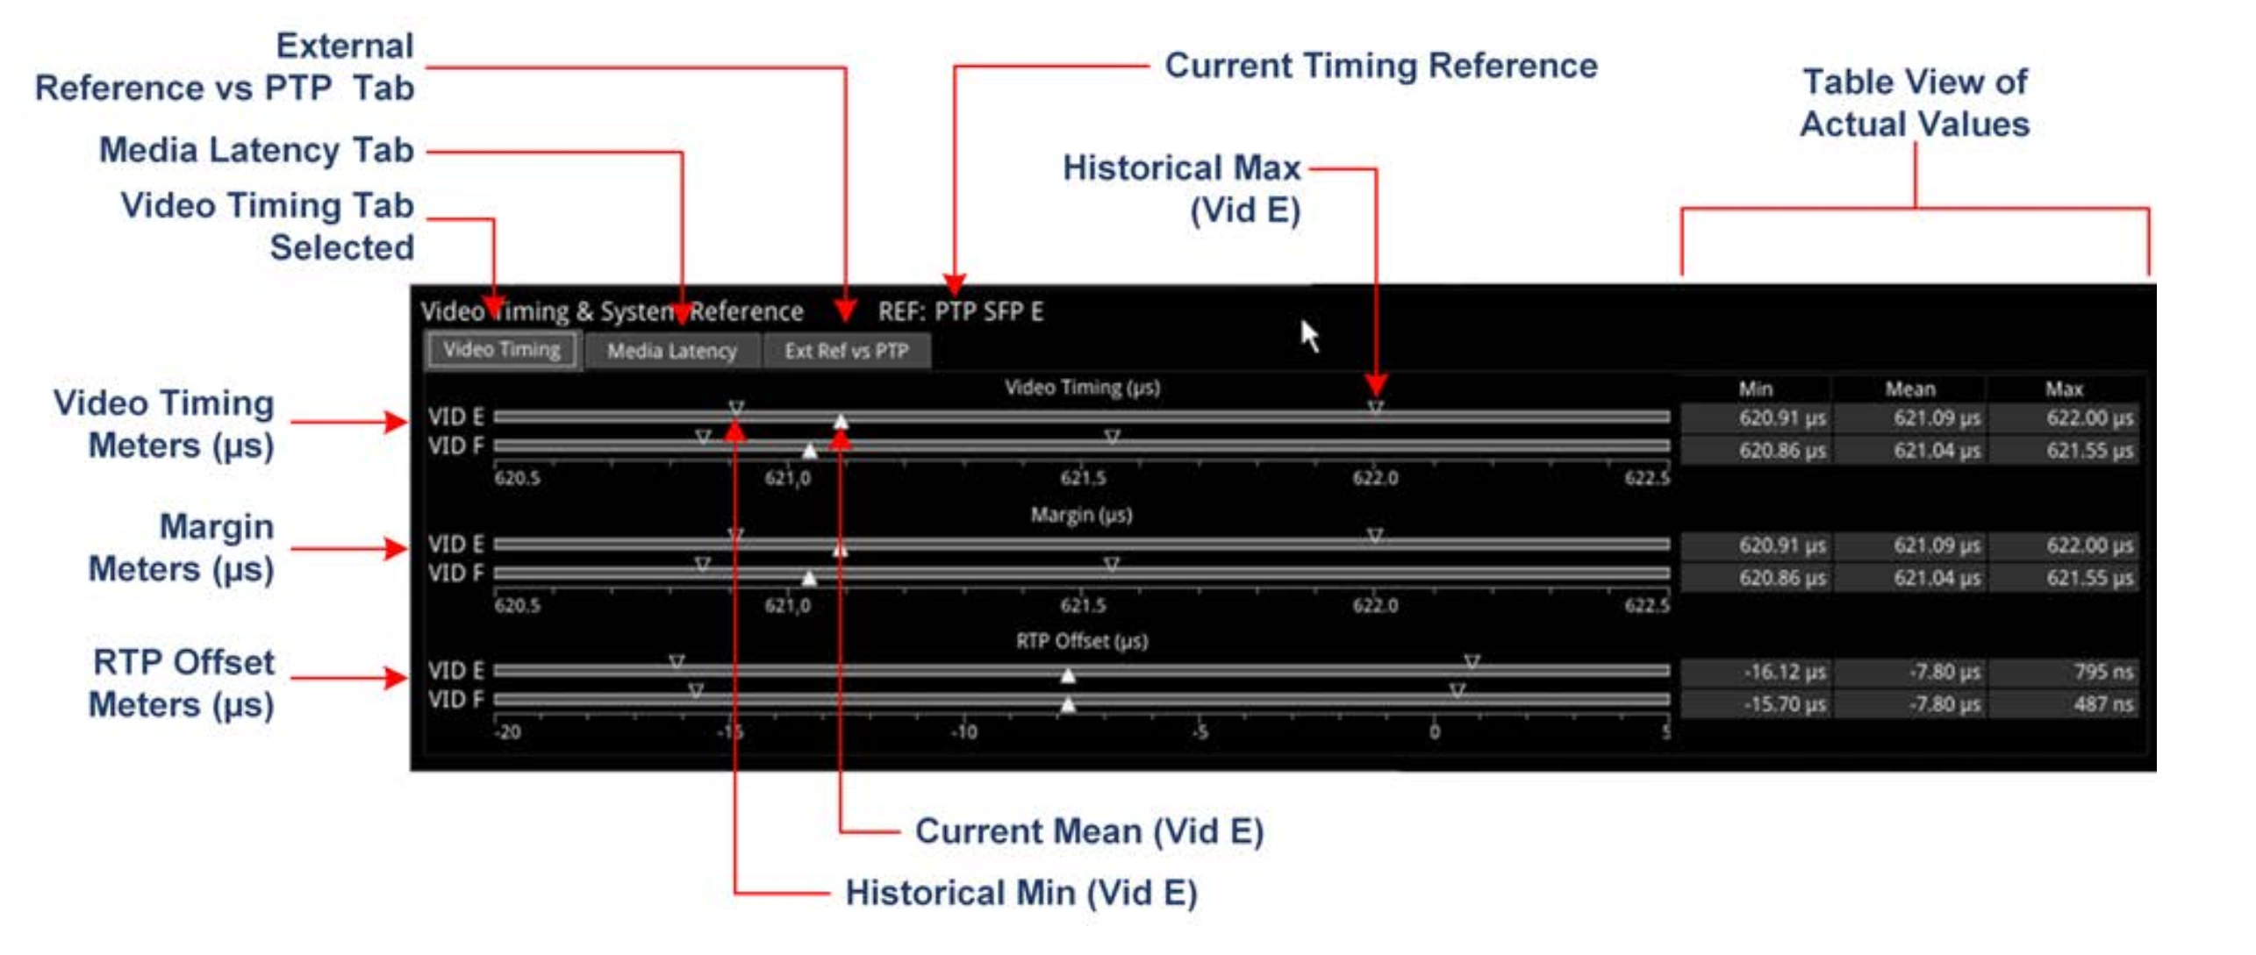
Timestamps vs packet arrival times
Similarly need to check both “Video Timing Meters” – packet arrival and “RTP offset Meters”
Note: may not have this screen on Phabrix, it requires PHQXO-IP-MEAS
Notes:
I had to read the manual to understand this

Slide 11
Measurements
Real senders in our lab (no GPS in our lab so it’s still 1970!):
1970-02-25 05:00:37+0000: First Packet arrived 0.758 ms after ideal, RTP-PTP offset 0.000us (0 rtp) – Packet arrival GOOD, RTP Timestamp GOOD
1970-02-25 05:01:27+0000: First Packet arrived 0.736 ms after ideal, RTP-PTP offset 11.111us (1 rtp) – Packet arrival GOOD, RTP Timestamp OK
1970-02-25 05:02:10+0000: First Packet arrived 0.791 ms after ideal, RTP-PTP offset -6655.556us (-599 rtp) – Packet arrival GOOD, RTP Timestamp BAD
Needs continual measurement in real facilities as sometimes jumps happen randomly (!)
Similar measurements for audio.

Slide 12
How a receiver should use timestamps
Receive a timestamp, count how many RTP wraparounds there from PTP Epoch (1st Jan 1970) to current PTP time. Then can realign received RTP timestamp with current PTP time and have absolute timestamp.
Straightforward with modulo arithmetic, though problematic if timestamps are too far in the future or the past
Synchronise video and audio and proceed with downstream processing
Some receivers not doing this as bad streams work fine into them. Can also send artificial streams with bad timestamps and decode process works, so devices not using timestamps.

Slide 13
Where/why things go wrong?
Non PTP locked SDI source routed into encapsulator (and encapsulator lacks a frame sync)
Symptom: Packet arrival times wrong or jittery, RTP timestamp bad
Fix: Genlock source or enable frame sync if available
Encapsulator produces invalid RTP timestamp (e.g fixed offset, jumps etc.)
Investigate whether transient (reboot to fix) or inherent issue in product
Some products take a while to settle to a valid RTP timestamp
Can be difficult to explain to vendor

Slide 14
Conclusions
Timestamps are an important part of 2110, receivers need them to match video and audio
They can be hard to measure and interpret
Maths can cause headaches
Timestamps often confused with packet arrival time
Need to be measured continually
Need to make sure encapsulators have frame syncs or all sources genlocked
Need to understand reasons for invalid timestamps

Slide 15
Any Questions?

Slide 16
Slide no bullets
Content – no bullets

Slide 17
Slide with bullets
Bullet 1
Bullet 2
Bullet 3
Bullet 4
Bullet 5

Slide 18
Image slide
Replace text box with image.
Delete side panel if image is too large to fit inside text box.

