Slide 1
Understand what is going on with your stream
Troubleshooting IP delivery network related problems
Adi Rozenberg, Alvalinks

Slide 2
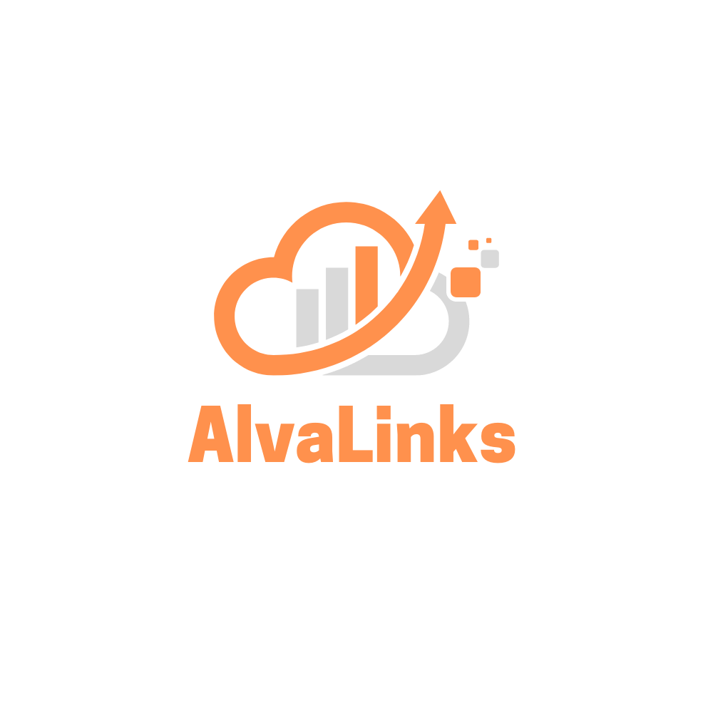
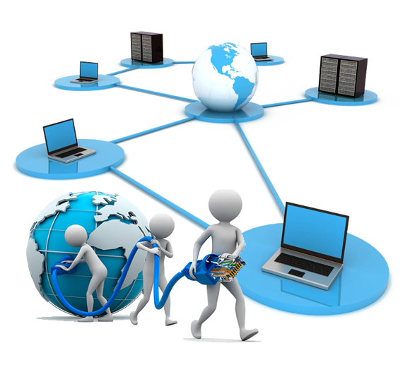
Introduction to Alvalinks
Alvalinks was founded by Broadcast and Networking veterans to bring innovation
Alvalinks focus on simplifying the road to the cloud and in the cloud, by way of delivery supported by AI toolset
Alvalinks is a VSF member
Adi Rozenberg is a long-time technology contributor to the RIST specifications

Slide 3
Understanding what is going on with my Stream
Why good transport is so important?
Why should I care?
What do I need to know?
What do I need to do?
How do I achieve that?
This presentation will address these questions

Slide 4
Why transport is so important?
Landmarks
Stars
Light house
Start
Vikings told us to FOLLOW the North star
In the past we needed to invent guidance tools to reach our destination
Someone told us to FOLLOW rivers, coast lines and land features to get to our destination
People BUILT Lighthouses to assist us
GPS
Compass
Maps
Use the global positioning to pin point and find the best route with traffic alerts for ON TIME delivery
Gave us better DIRECTION
Travelers DREW coast lines, rivers, cities, landmarks and areas to PASS or AVOID
How do we do the same in the cloud Era?
Cloud
Now IP is the new highway, where are the MAPS? COMPASSES? ASSITANCE?
Business success

Slide 5
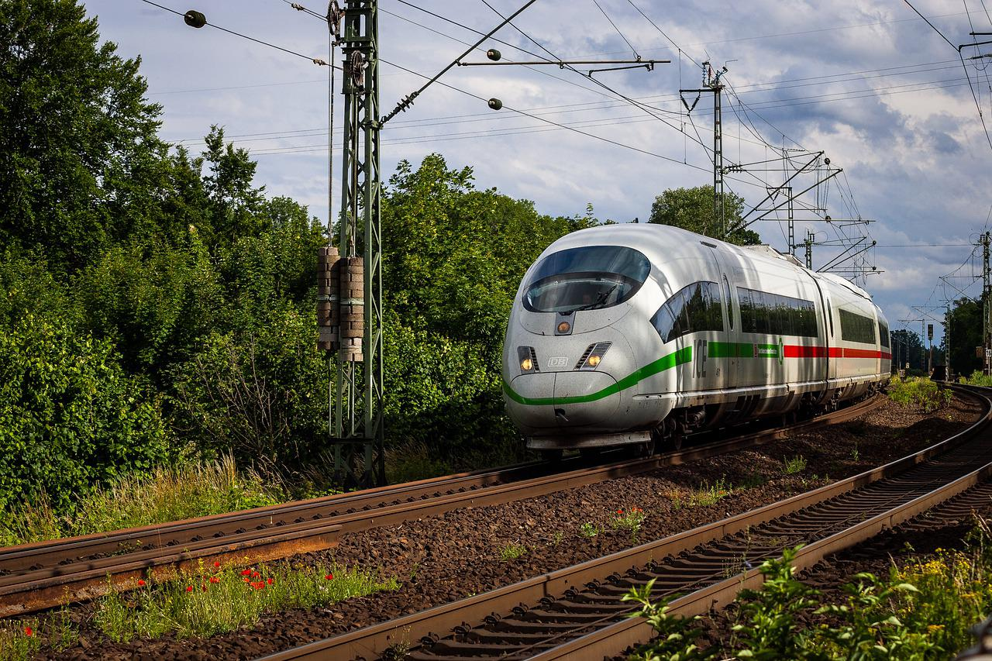
Internet vs Fiber
Fiber is similar to a train
Internet is similar to car traffic
HOPE
Reliable, single track
Piece of mind
You have choices and options
But you also have other users and traffic to consider
REALITY

Slide 6
Why should I care
IP based transport is becoming the new backbone of our industry with RIST, SRT, NDI, JPEG XS and ST2110 protocols fueling new applications, cloud workflows and a true enablers of the next technology leap to the cloud.
Networks are complex "living organisms" that are dynamic and have unpredictable behavior and performance.
Control or visibility - the cloud is yet another challenge that we need to overcome; it is increasing dramatically with scale, sites, interconnection between networks, and the integration of cloud operations – those are not under our control or visibility.

Slide 7
What is so different this days?
Remember the good old days?
ASI was a SIMPLE point to point
Satellite gave you ASSURED delivery and distribution
Fiber was PRIVATE
NOW, You are a part of a growing community of users
Other departments in your organization have some business in the cloud ( production, storage, SaaS etc )
Network may be shared by other organizations and streams
Over time the network will be come crowded

Slide 8
But my IT takes care of these, no?
Ask Yourself:
Did the IT get the E-mail on time?
Did they open the ports?
Did they setup the QOS ?
Did they secure the right SLA for me?
Do you have the right bandwidth?
Did the DevOps guys took care of the cloud ingest?
If the Answer is NO – you may be in trouble

Slide 9
Isn’t reliable streaming enough?
SRT, RIST, NDI and proprietary transport protocols have a share tasks:
Reliable delivery
Secure delivery
On time output
They are based on the assumption that the network is there.
It is your task to guaranty this all the time

Slide 10
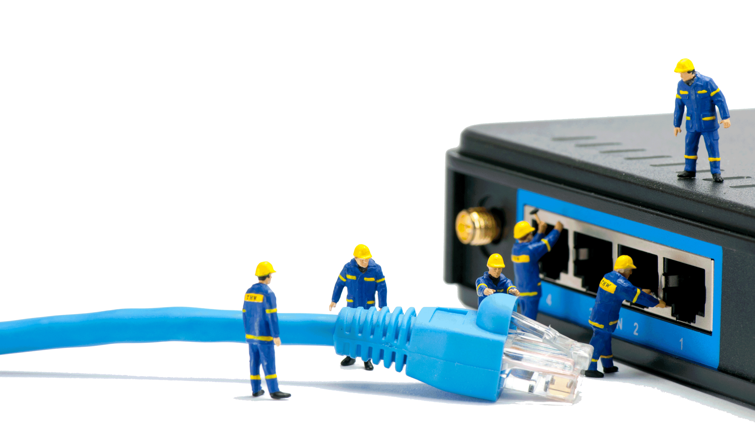
What do I need to know in advance?
Connectivity
Can I reach my destination?
Do I have the correct open ports
My available network paths
RTT
Number of Hops
Time to every hop
MTU limits
Packet loss
Jitter
Upload/download speed: max bitrate without errors, max bitrate with errors, packet loss, jitter
Abnormal artifacts for example; other flows, time interferences, network behavior etc.

Slide 11
What do I need to do while streaming?
Remember: you are NOT alone
You need to identify whatever may cause your stream to slowdown or breakdown:
RTT increase
Number of hops increase/decrease
Jitter increase
Packet loss increase
Additional flows going from the source or entering the destination
Seamless switching delay

Slide 12
What should I Keep track of?
Number of hops – detect network routing changes
RTT – detect delay that may impact Jitter events, ARQ recovery SMPTE2022-7 delay
Number of Packet loss in a window of time
Packet loss behavior – salt and pepper vs burst
Jitter increase – watch out for impact of packet loss
Multiple retries – reverse link issues or increase on pkts loss
Link bandwidth changes – cause excessive loss
Other flows on your links – bandwidth consumption

Slide 13
What are the option in my bag of tricks to identify a problem
Nmap – test open UDP/TCP ports in the destination Firewall
Ping – test RTT, sample packet loss ( poor results )
TraceRoute/Tracepath – test number of hops, RTT based on Ping for each hop
Iperf – test upload speed, max bandwidth, Packet loss and Jitter
Tcpdump – capture packet and detect other flows
Vnstat – report on Rx/Tx bitrate and packet rate to detect bandwidth drop
Protocol specific reports of bandwidth, packet loss, packet rate

Slide 14
How do we isolate and avert it a problem
Trust and Verify everything before starting any live stream
Use more than one Link to assure redundancy
Monitor the stream behavior
Watch for packet loss : spread or burst
Unrecovered events
Jitter increase
RTT reports
Unknown flows
Test the link bandwidth from time to time
Don’t allow your connection to go wild on you

Slide 15
Adi Rozenberg, CTO
Adi.Rozenberg@Alvalinks.com

Slide 16
Any Questions?

