Slide 1
PTP: The Key to ST 2110 Timing
Andrew Scott, Telestream

Slide 2
Precision Time Protocol – History
Designed to synchronize clocks via a computer network, with much higher accuracy than NTP
Widely used in industries such as telecom and finance, now being adopted for video applications to replace analog sync
Version 1 published as IEEE 1588-2002, not used for video
Version 2 published as IEEE 1588-2008
Updated with IEEE 1588-2019 (“Version 2.1”)
Augmented with standards such as SMPTE ST 2059-2 (since 2015)
Some terminology has changed: Master/Slave → Leader/Follower

Slide 3
PTP over IPv4
User Datagram Protocol (UDP) used for transport
Port 319 for Event messages
Port 320 for General messages
Multicast group address for most messages: 224.0.1.129
Exchange of PTP messages may be multicast, unicast, or a mix of both

Slide 4
Common PTP Message Types
Event message class
Sync
Delay_Req
General message class
Announce – used to establish the synchronization hierarchy
Delay_Resp
Follow_Up
Management – used to query and update “data sets” used by PTP instances
Differentiated Services used by switches to enforce high priority for event messages

Slide 5
Clock Synchronization
Sync messages sent periodically (e.g. 8 per second) from leader to followers
Follow_Up message needed only if Sync timestamp is not included in the Sync message
Followers send Delay_Req, typically at same rate as Sync
After complete exchange, followers have all 4 timestamps

Slide 6
Clock Synchronization
$t_{ms}= t_{2} − t_{1}$
$t_{sm}= t_{4} − t_{3}$
$meanDelay= \frac{t_{ms} + t_{sm}}{2}$
$offset= \frac{t_{ms} − t_{sm}}{2}$
Follower clock can be adjusted using these values
There is also a provision for asymmetric network delays

Slide 7
PTP Clock (Node) Types
Ordinary Clock
PTP nodes with a single port on the network
Can be either a follower or a leader
Typically in video networks, we have grandmaster (GM) clocks that are leader-only and devices (cameras, etc.) that are follower-only
Boundary Clock
Multi-port device (i.e. switch) with one follower (synced to the GM) and many leaders on all other ports
Provides scalability in large PTP networks
Transparent Clock
Switch that updates timestamps in PTP messages but does not assume a role

Slide 8
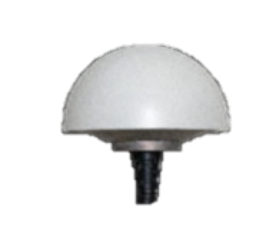
Media Network Architecture
Redundant network for resiliency
Leaf/Spine switches (boundary clocks) for scalability
Hybrid facility with PTP → analog to support legacy devices
GNSS
Sync Gen Grandmaster
Spine
PTP Only
Spine
Amber (primary) network
Blue (backup) network
Leaf
Leaf
Leaf
Leaf
Leaf
Leaf
Leaf
Leaf
Camera
Display
Media Node
Analog Sync Signals
Legacy Devices

Slide 9
Lead Clock Determination
Announce messages are sent periodically (typ. 1 per second) and include (in priority order):
Priority 1 – user-configured
Clock Class – GNSS locked, holdover, free-running, etc.
Clock Accuracy – estimate based on time source, e.g. “within 25 ns”
Clock Variance – computed stability of local clock
Priority 2 – user-configured
Clock Identity – (tie-breaker) based on MAC address
Potential leaders use the Best Master Clock Algorithm (BMCA) to decide which node is the sync source

Slide 10
Best Master Clock Algorithm
Leader clocks listen for other Announce messages
Start sending Announce when better than received Announce
Or when no Announce received (timeout is usually 3s)
Stop sending Announce (go to Passive) when a better leader is seen
Power On, Reset
Listen
Announce from
better leader
No announce from
better leader
Passive
No announce from
better leader
Grandmaster
Announce from
better leader

Slide 11
PTP Domains
Domain is simply a numeric identifier (0-255) for a logical PTP network
Multiple domains can co-exist on a physical network
For example, separate audio (AES67) and ST 2110 domains
Every PTP message includes the domain number so nodes can accept or discard the message as appropriate

Slide 12
PTP Profiles
A profile is a set of PTP options and attributes for a given application
Message rate defaults and permitted limits (Announce, Sync, etc.)
Communication models (e.g. multicast, unicast, mixed)
IEEE 1588-2019 specifies the “Delay Request-Response Default PTP Profile”
SMPTE 2059-2:2021 specifies the “SMPTE profile for synchronization in a professional broadcast environment”
AES67-2018 specifies the “PTP profile for media applications”
Other profiles for telecom and other applications

Slide 13
SMPTE 2059-2
Specifies the PTP profile used by ST 2110
Permits three communication models:
Multicast for all messages
Unicast for all messages. Followers are configured with a list of potential leaders and use a “grant” mechanism to request that the leader send unicast Announce, Sync, and Delay_Resp messages
Mixed – Announce, Sync (& Follow_Up) and Management messages are sent by multicast. Delay_Req/Delay_Resp are sent by unicast (without grant)
Adds a synchronization metadata TLV in Management messages to signal time code information to media nodes (e.g. next jam time)

Slide 14
Best Practices
Create a solid network plan
Redundant amber/blue networks
Switches that support PTP, ideally Boundary Clock mode
Scalable switch architecture – Spine/Leaf
Use PTP-only link between amber/blue networks so that GMs can see each other’s Announce messages
All devices see the same GM on both networks
Configure switch ports “role master” to prevent rogue leaders
Use SMPTE 2059-2 profile and default message rates
Use Mixed Multicast/Unicast communication model

Slide 15
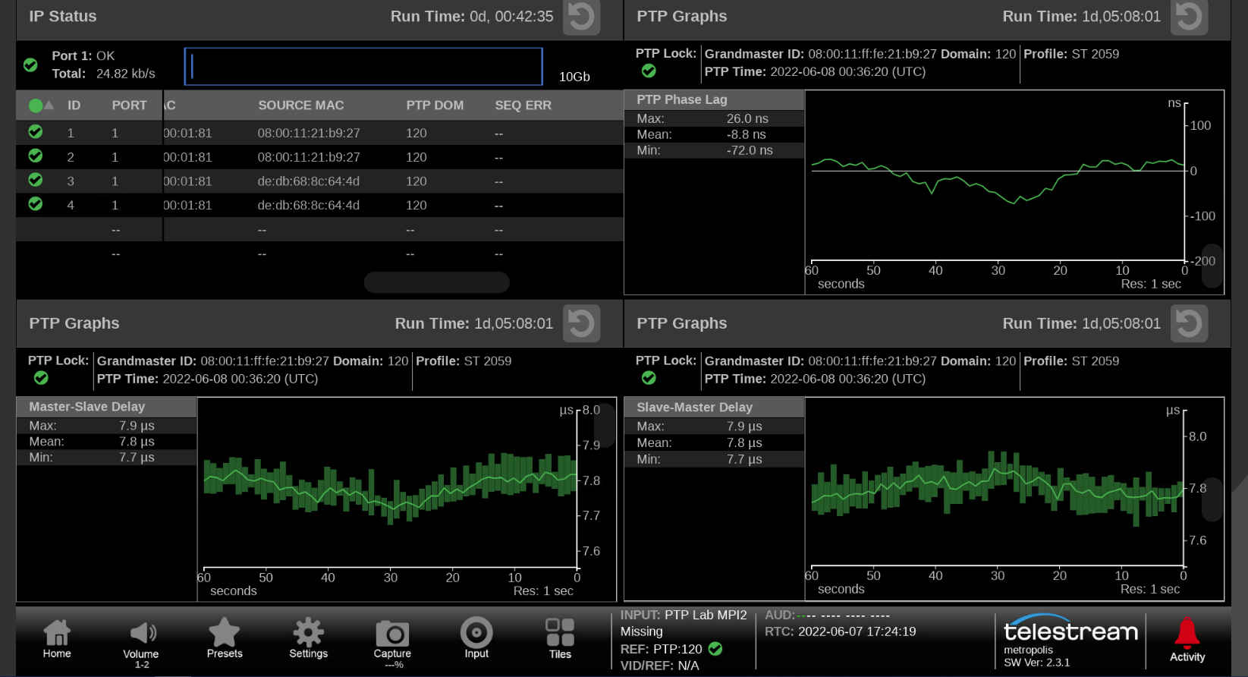
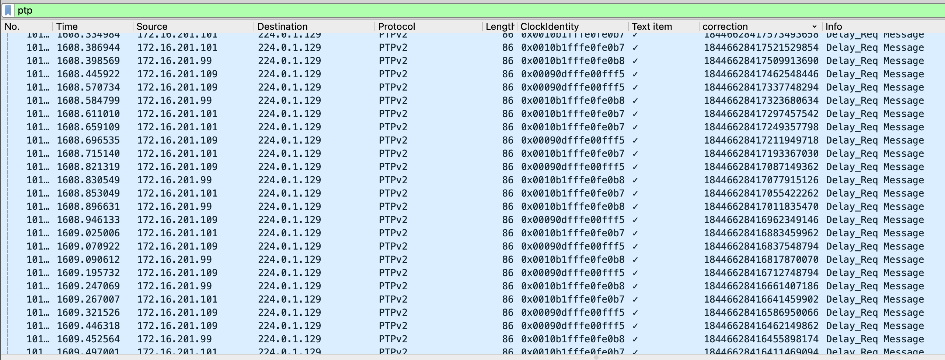
Troubleshooting Tools
PTP monitoring and measurements
Wireshark packet captures for offline analysis

Slide 16
Any Questions?

