Slide 1
IP Showcase ST 2110 LaunchPad
Wes Simpson, Founder, LearnIPvideo.com
LearnIP
video.com

Slide 2
Key Requirements for IP Video Systems
Function | Description | Standards
Encapsulation | Put media data into IP packets | Video: ST 2110-20 Audio: ST 2110-30 & AES67 Ancillary Data: ST 2110-40

Slide 3
Key Requirements for IP Video Systems
Function | Description | Standards
Encapsulation | Put media data into IP packets | Video: ST 2110-20 Audio: ST 2110-30 & AES67 Ancillary Data: ST 2110-40
Synchronization | Align media streams to a common clock | IEEE 1588 PTP – Precision Time Protocol ST 2059 and ST 2110-10

Slide 4
Key Requirements for IP Video Systems
Function | Description | Standards
Encapsulation | Put media data into IP packets | Video: ST 2110-20 Audio: ST 2110-30 & AES67 Ancillary Data: ST 2110-40
Synchronization | Align media streams to a common clock | IEEE 1588 PTP – Precision Time Protocol ST 2059 and ST 2110-10
Switching and Routing | Move packets from one device to another | IGMPv3 Multicasting

Slide 5
Key Requirements for IP Video Systems
Function | Description | Standards
Encapsulation | Put media data into IP packets | Video: ST 2110-20 Audio: ST 2110-30 & AES67 Ancillary Data: ST 2110-40
Synchronization | Align media streams to a common clock | IEEE 1588 PTP – Precision Time Protocol ST 2059 and ST 2110-10
Switching and Routing | Move packets from one device to another | IGMPv3 Multicasting
Connection Management | Route signals from sources to destinations | SDP – Session Description Protocol NMOS IS-05

Slide 6
Media Transport over IP
SMPTE ST 2022-6
SMPTE ST 2110

Slide 7
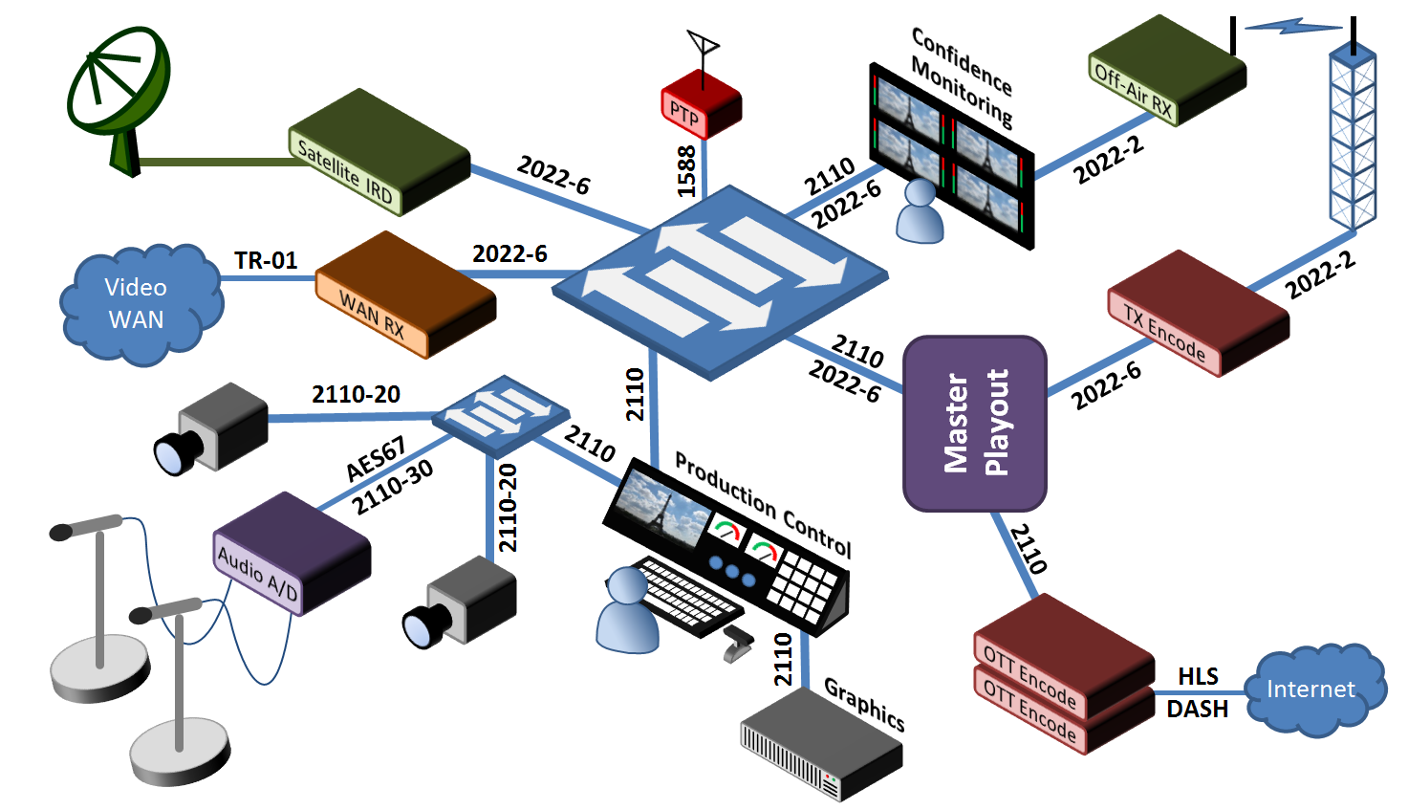
The IP Video Ecosystem
Replace text box with image.
Delete side panel if image is too large to fit inside text box.

Slide 8
IP Media Evolutionary Tree
Compressed
Uncompressed
ST 2022-7
IPMX
TR-08
ST 2110-22
ST 2110-21
RP 2110-23
RP 2110-24
ST 2110-31
TR-07
ST 2110-10
ST 2110-20
ST 2110-30
ST 2110-40
RIST
ST 2022-3,4
ASPEN
RDD 37
ST 2022-8
ST 2110
TR-01
TR-04
RFC 8331
ST 2022-5,6
TR-03
ST 2022-1,2
AES 67
Pro-MPEG CoP3
RFC 4175
>> Note that ALL these signals could co-exist on the SAME IP network <<

Slide 9
SMPTE ST 2022-6
Specifically designed for transporting SDI signals over IP
270 Mbit/s, 1.485 Gbit/s and 2.97 Gbit/s
Carries entire SDI signal intact
Video, embedded audio, ancillary data, HANC, VANC and all other bits
Permits bit-for-bit copy of signal to be transported across IP network
Works with ST 2022-5 Forward Error Correction
Row/Column FEC handles lost RTP datagrams
Separate UDP ports used for transmission of SDI and FEC

Slide 10
Media Transport over IP: SMPTE ST 2022-6
Take entire SDI signal and encapsulate into one IP stream
Includes audio and embedded data signals
Easy to maintain audio/video synchronization
Hard to process just one part of a stream
Data
IP Packet Network
Data
Audio
Embed
Packetize
De-packet
De-embed
Audio
SDI
Video
ST 2022-6 IP Packets
Video/Audio/Data
SDI
Video

Slide 11
SMPTE ST 2110
General-purpose media transport over IP
Standards for video, audio, synchronized metadata
Carries each media element as a separate stream
Video in one stream, one or more audio channels in another, metadata in another
Capable of handling wide variety of formats
Video from SD all the way up to 8K HDR and beyond
Compressed and uncompressed video at any frame rate
Multi-channel audio at multiple sampling rates
Many different categories of metadata

Slide 12
Media Transport over IP: SMPTE ST 2110
Each media type in a separate packet stream
Easy to process individual components
Signals need to be resynchronized after processing
PTP (Precision Time Protocol) used for packet timestamping
SDP Files used to describe each packet stream
IP Packet Network
Data
Packetize
ST 2110-40 Data
De-packetize
Data
Audio
ST 2110-30 Audio
Audio
SDI
Video
SDI
Video
ST 2110-20 Video
SDP Files

Slide 13
ST 2022-6 / ST 2110 Audio Processing Packet Flow
Using SDI/ST 2022-6
Using ST 2110
Audio
Processing
Audio
Processing
De-embed
Embed
De-pack/Pack
De-packet
Packetize
IP Packet Network
Data
Packetize
De-packetize
Data
Data
IP Packet Network
Data
2110-30
Audio
Audio
Audio
Audio
Embed
Packetize
SMPTE 2022-6 IP Packets
Video/Audio/Data
De-packet
De-embed
Audio
SDI
Video
SDI
Video
SDI
Video
SDI
Video
ST 2110-20 Video
SDP Files

Slide 14
SMPTE ST 2110 – Released Standards
OV 2110-0 Roadmap for the 2110 Document Suite
ST 2110-10 System Timing and Definitions
ST 2110-20 Uncompressed Active Video
ST 2110-21 Traffic Shaping and Delivery Timing for Video
ST 2110-22 Constant Bit-Rate Compressed Video
ST 2110-30 PCM Digital Audio (uncompressed)
ST 2110-31 AES3 Transparent Transport (for non-PCM audio)
ST 2110-40 SMPTE ST 291-1 Ancillary Data
ST 2110-43 TTML for Captions and Subtitles

Slide 15
ST 2110-20 Video Encapsulation
RTP Payload Header
MAC
IP
UDP
RTP
PH
pg
pg
pg
pg
pg
pg
pg
CS
Multiple video pixel groups (pgroups)
RTP Payload Header applied (unique to each media type)
Inserted into an RTP packet
Placed into UDP packet
IP packet header attached
Wrapped into Ethernet Frame

Slide 16
ST 2110-20 Pixel Groups
Pixels formed into pgroups
pgroup size depends on sampling format
Must be integer number of octets
Pixels that share samples must be in the same pgroup
Example: 4:2:0 8-bit groups 4 pixels into 6 octets
Example: 4:2:2 10-bit groups 2 pixels into 5 octets
Y’00
Y’01
Y’10
Y’11
C_{b}’
C_{r}’
1
2
3
4
5
6
C’_{B}
Y0’
C’_{R}
Y1’
1
2
3
4
5

Slide 17
ST 2110-20 Sample Row Data
Ancillary Data (VANC)
Packet 0
Packet 1
Packet 2
Active Video
(e.g. 1920x1080)
Packet 0
Packet 1
P 2
Packet 2
X
2X
Embedded Audio
(HANC)

Slide 18
Lossless Compression
Visually lossless compression cannot be seen by observer
Some data must always be removed
Done so as to be invisible to human viewer
Can have very low latency (~1 millisecond or less, encode + decode)
Popular codecs available
JPEG XS – RTP Encapsulation – RFC 9134
Also VC-2 DIRAC from BBC – RFC 8450
2:1 to 8:1 compression ratio
3Gbit/s SDI compressed to 1.5 to 0.5 Gbit/s

Slide 19
Compressed Video Signal Rates
Often measured in bpp (bits per pixel)
Uncompressed SDI used 4:2:2 10-bit video
Works out to 20 bits/pixel
Note that SDI also has HANC and VANC occupying significant bandwidth
Video Format | Pixels/frame | Pixels/second | “SDI” bit rate | 1 bpp | 3 bpp | 6 bpp
720p60 | 921,600 | 55,296,000 | 1.485 Gbit/s | 70 Mbit/s | 195 Mbit/s | 390 Mbit/s
1080i60 | 2,073,600 | 62,208,000 | 1.485 Gbit/s | 70 Mbit/s | 195 Mbit/s | 390 Mbit/s
1080p60 | 2,073,600 | 124,416,000 | 2.97 Gbit/s | 150 Mbit/s | 390 Mbit/s | 780 Mbit/s
4K 2160p60 | 8,294,400 | 497,664,000 | 11.88 Gbit/s | 500 Mbit/s | 1.4 Gbit/s | 2.8 Gbit/s
8K 4320p60 | 33,177,600 | 1,990,656,000 | 47.53 Gbit/s | 2 Gbit/s | 5.6 Gbit/s | 11.2 Gbit/s

Slide 20
ST 2110-30 Audio Encapsulation
1 msec
4 channels of 96 kHz 24-bit audio
95
4
3
2
1
0
96 ea. 24 bit Samples (3 bytes) @ 96 kHz
Each Channel has 3 x 96 = 288 bytes per packet
4 Channels have 4 x 288 = 1,152 bytes
All channels in one IP Packet
Maximum theoretical capacity – 5 channels, 1440 bytes
One ST 2110-30 Packet
95
95
95
95
2
2
2
2
1
1
1
1
0
0
0
0
RTP
UDP
IP

Slide 21
2110-40 Ancillary Data
Extract ancillary ST 291 data packets from VANC or HANC
Captions, time code, ad triggers, etc.
Place them into RTP packets with custom header
Line numbers are based on SDI line numbering
Don’t match 2110-20 line numbers
Ancillary Flag
DID
SDID
DC
User Data
CS
ANC Data
Packet
000 3FF 3FF
41
07
xx
SCTE 104
zz
RTP Header
Payload Hdr.
Anc. Packet Header
DID
SDID
DC
User Data
CS
RTP
Datagram
Seq. #, SSRC
01
Line #, Offset
41
07
xx
SCTE 104
zz

Slide 22
IP Transport
RTP Encapsulation
Timing

Slide 23
RTP Packet Features
M-Bit – Media-specific indicator flag
In ST 2110 video, indicates last packet of video frame
RTP Header
16 Bits
Payload Type
Indicates type of media in packet (video/audio/etc.)
V
P
X
CC
M
Payload Type
RTP Sequence Number (low 16 bits)
Sequence number
Each packet in a stream has a unique number
Permits packets to be put into correct sequence
Allows missing packets to be detected
Time Stamp
Synchronization Source
(SSRC) Identifier
Timestamp
Indicates when media content was created
Multiple packets may share one timestamp

Slide 24
All Signals in Phase at SMPTE Epoch
SMPTE Epoch – Jan. 1, 1970, 00:00:00 TAI
Other signals
tied to SMPTE Epoch
50 Hz
video
t=0
t=20
t=40
Current time
t1
t2
Next
alignment point

Slide 25
ST 2110-20 RTP Timestamps and Sequence Numbers
All packets from one video frame will have the same RTP timestamp
However, RTP Sequence number is always incremented by one for each packet
For interlaced video, the packets for each field will have the same timestamp
Timestamp will jump for each frame of video
By a count equal to the clock rate (90 kHz) divided by the video frame/field rate
Frame N
Frame N+1
Frame N+2
TS = 20000
Seq. = 7999
TS = 21800
Seq. = 8000
TS = 21800
Seq. = 8001
TS = 21800
Seq. = 8002
TS = 21800
Seq. = 11999
TS = 23600
Seq. = 12000

Slide 26
500 Mbps Signal on a 10 Gbps Link
10 kbit packets for
1 microsecond
19 microsecond gap

Slide 27
Two 2.5 Gbit/s Signals on Two 10 Gbps Links
Two signals will collide
if both are burst-mode
Switch buffers will overflow if muxed
onto a single link

Slide 28
Type N, NL and W Packet Pacing
Bit Rate
Variation
Type NL
Packet
Moving Average
Bit Rate
Bit Rate
Variation
VANC
Type N
Bit Rate
Variation
Type W

Slide 29
ST 2022-7 Hitless Protection Switching
Send identical signal on two separate paths
Identical RTP packet timestamps, RTP sequence numbers
Receiver aligns packets using buffer
Transit time equal to delay of longest path
SMPTE ST 2022-7 Standard
“Seamless Protection Switching of RTP Datagrams”
Published in 2019
Path A
Source
Destin-
ation
Path B

Slide 30
SDP Example for 1080i 29.97Hz Video
v=0
o=wes 203763372 89 IN IP4 10.201.33.19
s=Example of a 1080i29.97 video signal
t=0 0
m=video 31008 RTP/AVP 101
c=IN IP4 232.201.33.11/32
a=source-filter: incl IN IP4 232.201.33.11 10.201.33.19
a=rtpmap:101 raw/90000
a=fmtp:101 sampling=YCbCr-4:2:2; width=1920; height=1080; interlace; exactframerate=30000/1001; depth=10; TCS=SDR; colorimetry=BT709; PM=2110GPM; SSN=ST2110-20:2017
a=ts-refclk:ptp=IEEE1588-2008:39-A7-94-FF-FE-07-CB-D0:42
a=mediaclk:direct=0

Slide 31
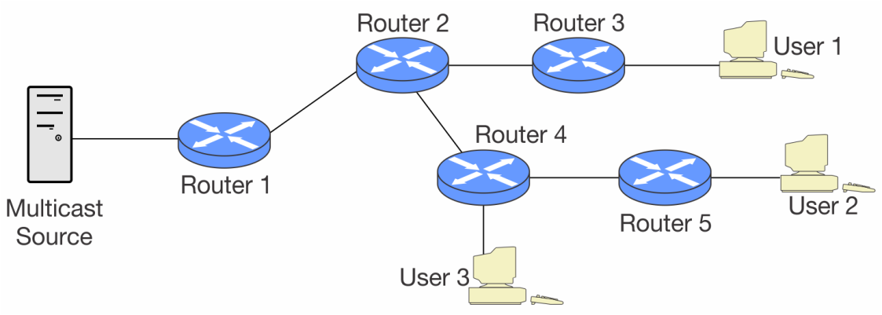
Multicast Stream Dynamics
Source offers stream via multicast addresses listed in SDP
Destination devices get SDP via NMOS or other means
Receivers generate requests to join multicasts using IGMPv3
Network determines best way to deliver streams
SDP File

Slide 32
ProAV Format Comparison
Capability/Feature | IPMX | ST 2110 | SDVoE | HDBaseT
Uncompressed 4K60p Video | Yes | Yes | No | No
Visually Lossless Compression | Yes | Yes | Yes | No
Network-based Precision Clock (PTP) | Optional | Required | No | No
Open Standard | In process | Yes | No | No
HDCP Support | Yes | No | Yes | Yes
ST 2110 Compatibility | Yes | Yes | No | No
IR Control Link | No | No | No | Yes
PoE (Power over Ethernet) | Possible | No | No | Yes
PoH (Power over HDBaseT) (100W) | No | No | No | Yes
Data Channel* | Not Required | Not Required | Up to 1 Gbit/s | Up to 100 Mbit/s
*IPMX and ST 2110 work over standard IP/Ethernet infrastructure. As such, other IP and Ethernet data flows can easily be transported over the same networks.

Slide 33
So, Why ST 2110?
Futureproof
Can handle any video format: 8K, HDR, 3D, and beyond
Cloud-Friendly
IP signals travel easily to and from public and private clouds
Flexible
Common network backbone handles SD, HD, UHD, SDR, HDR, multiple frame rates, compressed/uncompressed, streaming, file transport and much more

Slide 34
Emmy-award Winning Technology

Slide 35
Any Questions?
LearnIP
video.com

